Slide 1

An online tools rental platform
By: Laith Hussam Shono
101708516

Slide 2
Problem
Notes:
The main problem the project is trying to solve is people buying new tools instead of renting them.
This itself results in many problems. For example,

Slide 3

Problem
Buying a new tool instead of renting presents some problems:
Waste of money
Buying a new tool is more costly.
The tool gets used only once.
Cluttering the storage space.
Environmental problems
More demand results in more manufacturing.
More carbon emissions.
More trash.
Notes:
The main problem the project is trying to solve is people buying new tools instead of renting them.
This itself results in many problems.

Slide 4
Objectives

Slide 5
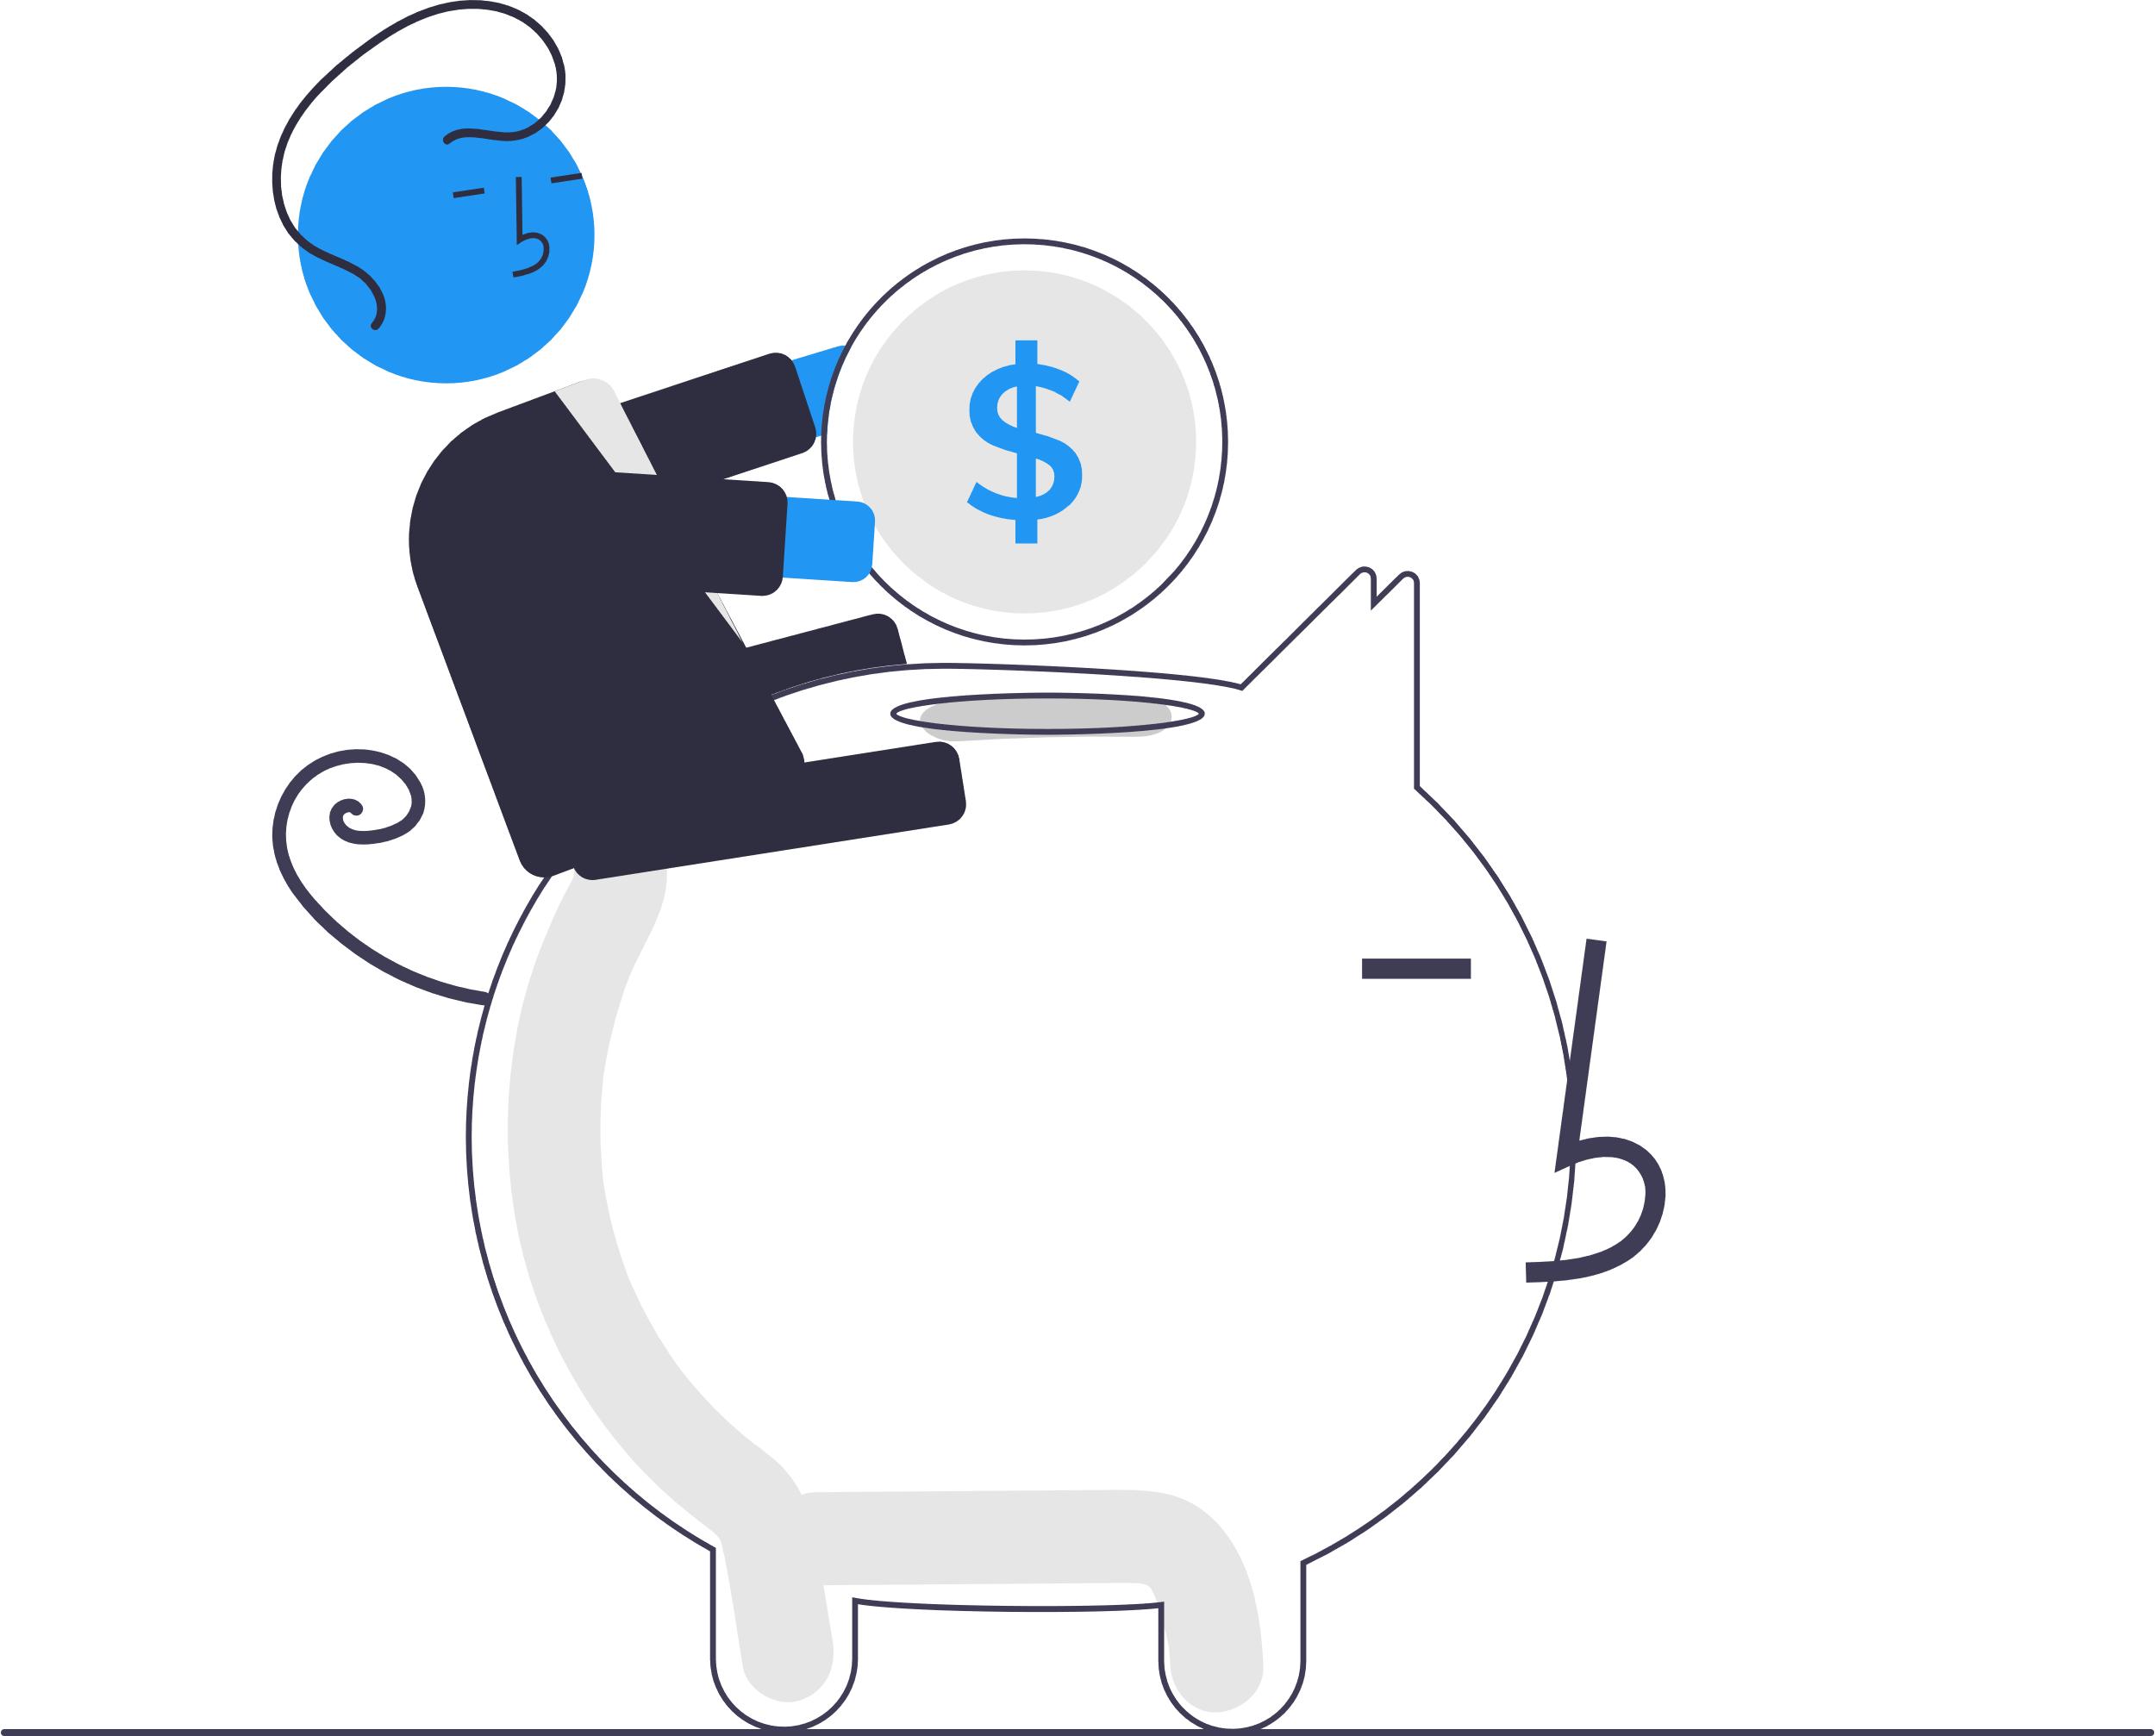
Objectives
Provide a way for tool owners to offer their tools for rent.
Provide a way for people to rent other people’s tools.
Protect the owners and renters from scams as much as possible.
Benefits:
For owners
For renters
For the environment
Offer their tools for rent.
Make some money.
Rent tools instead of buying new ones.
Save money from buying new tools and maintaining them.
Try something before buying it.
Reusing tools will results in:
Less manufacturing.
Less carbon emissions.
Less trash.
Notes:
The project aims to
This would benefit:
The owners
By providing a way to make their tools work for them and making some money out of it.
The renters
So, they can rent tools instead of buying new ones
Saving money on the purchase and maintenance.
Or they can rent something to try it before buying it.
And the environment
Reusing tools will results in:
Less manufacturing.
Less carbon emissions.
Less trash.

Slide 6
Current rental services.

Slide 7

Current rental services.
There are some online rental services available. However, most of them are business-to-consumer (B2C), such as HSS Hire and United Rentals.
The P2P platforms (e.g., Rent4Me, MyRent) have some choices that may not be the best. For example:
Posts and IDs needing to be verified and accepted by an administrator to be published and available to other users.
For some platforms, verifying a user is not required for him/her to send requests.
Not taking some steps to protect the users from scams. Like taking pictures of the tool before starting the rent.
Notes:
B2C: which means they are businesses offering their own tools for rent/hire. Where you select a tool, check for availability in one of their stores, and pick it up from there.
Admins reviews: Rent4Me
While these methods seem better and more secure at first, they could push away the users since it delays the user experience, especially when the user base gets larger, and moderation starts taking longer. Instead,
it’s better to let the users evaluate the posts and IDs themselves while giving them instructions and tips on how to do so
No verification: Rent4Me
Scams
To have proof of the tool’s status before rent starts. And a way to verify these pics and vids are actually genuine (not taking a month ago when the tool was fine)

Slide 8
Solution

Slide 9

Solution
A P2P rental platform that users will create account in where they can:
Offer their tools for rent.
Rent other users’ tools.
All while taking steps to protect them from scams.
The system is available as an Android app, an iOS app, and a web app. Making it available from any device.

Slide 10
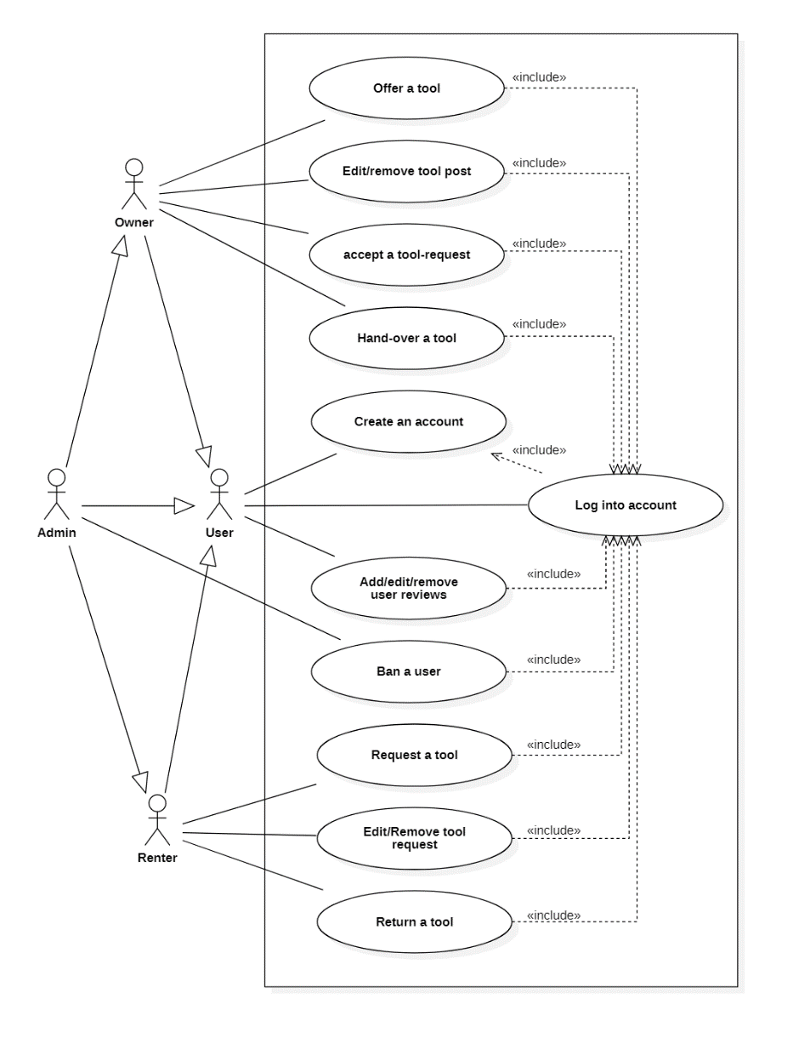
Solution
The owner creates a post of the tool where he/she can receive requests on.
The renter send a request with how many days and a description.
The owner accepts the request, and a chat room opens.
They both agree to meet at a place to give the tool to the renter (This meeting is called the delivery meeting).
Then after the renter is done, they meet again to return the tool (This meeting is called the return meeting)
Use case diagram

Slide 11
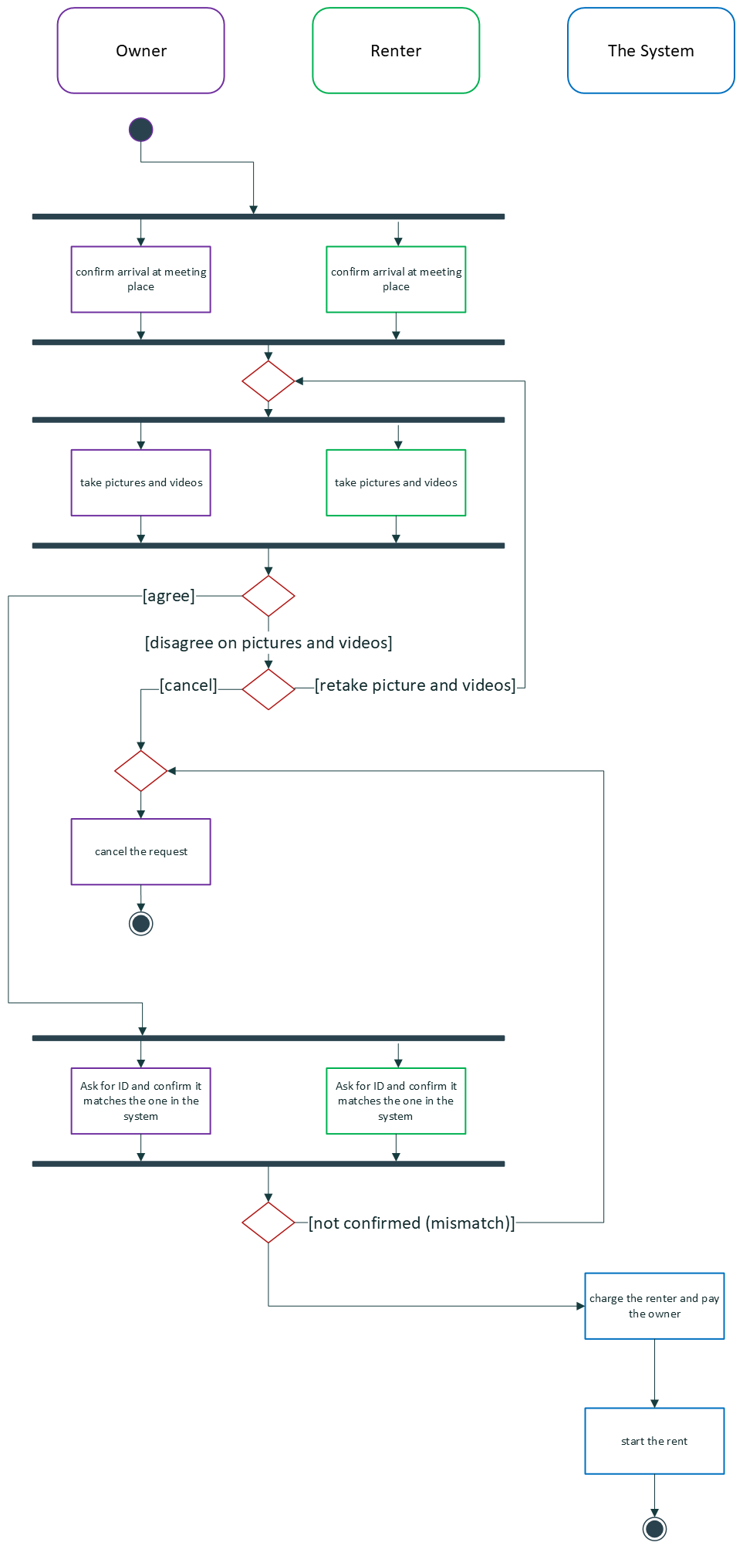
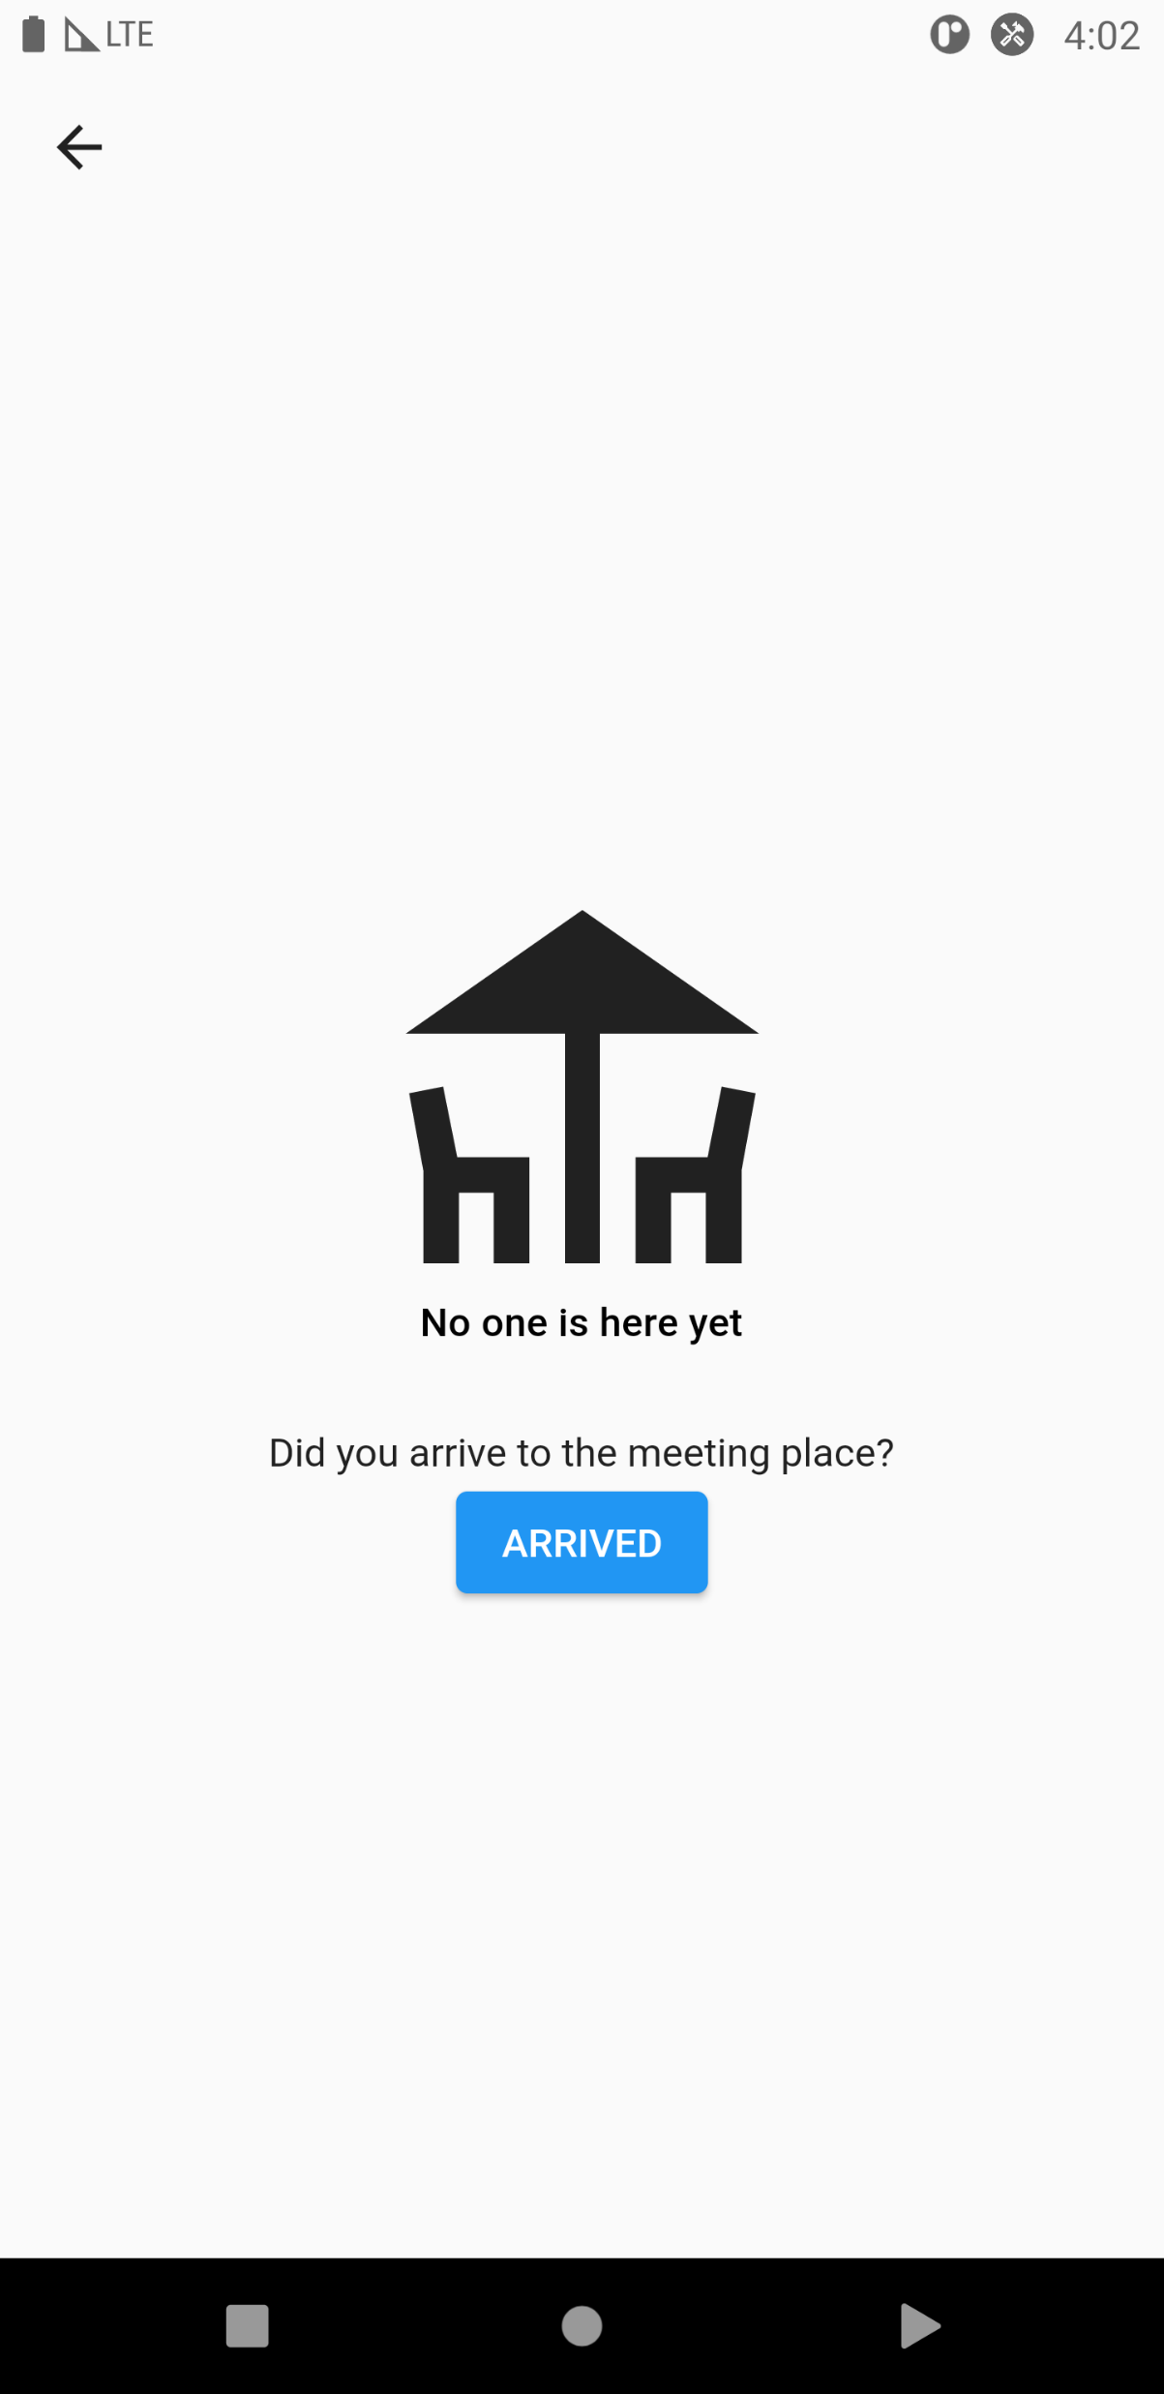
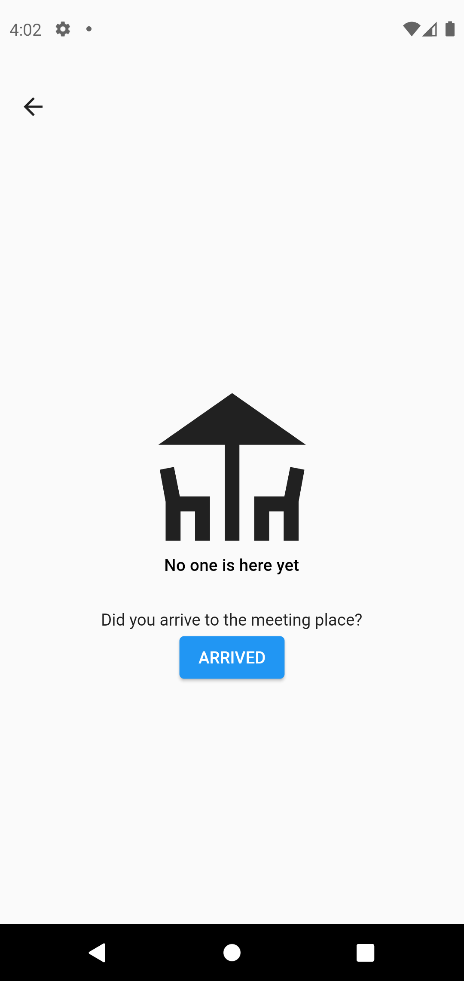
The delivery meeting flow
Renter
Owner
Notes:
They open the delivery meeting page and they must confirm their arrival

Slide 12
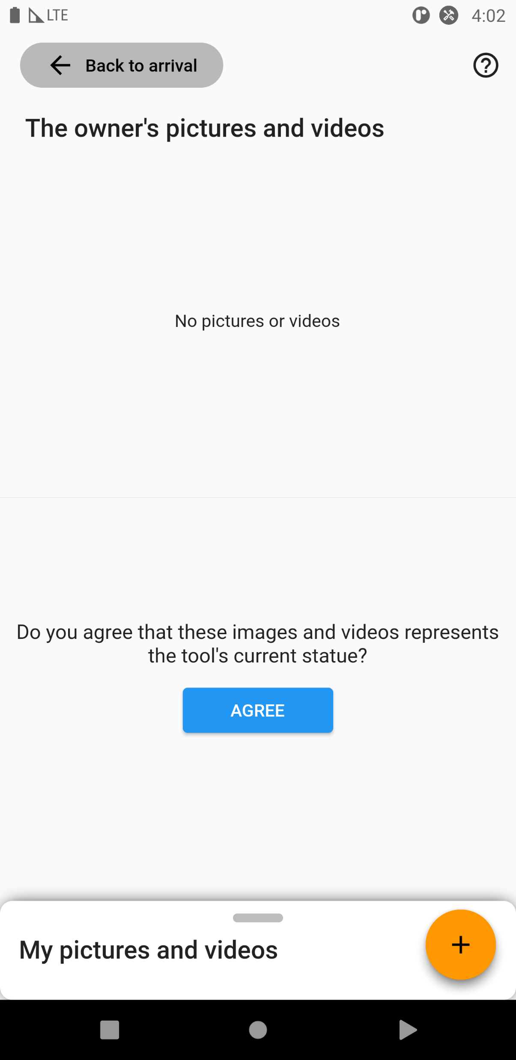
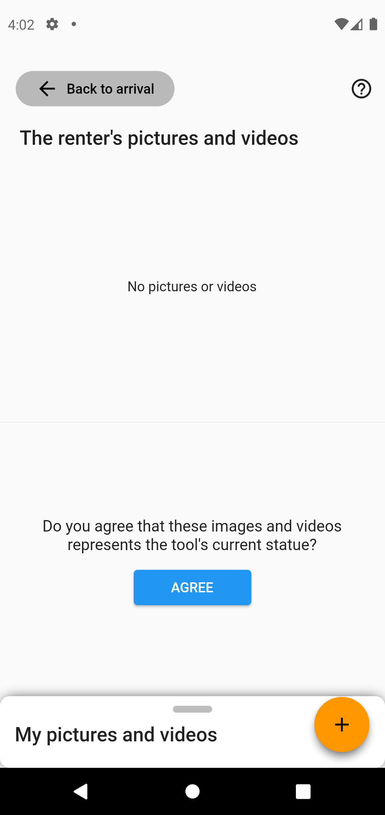
The delivery meeting flow
Renter
Owner

Slide 13
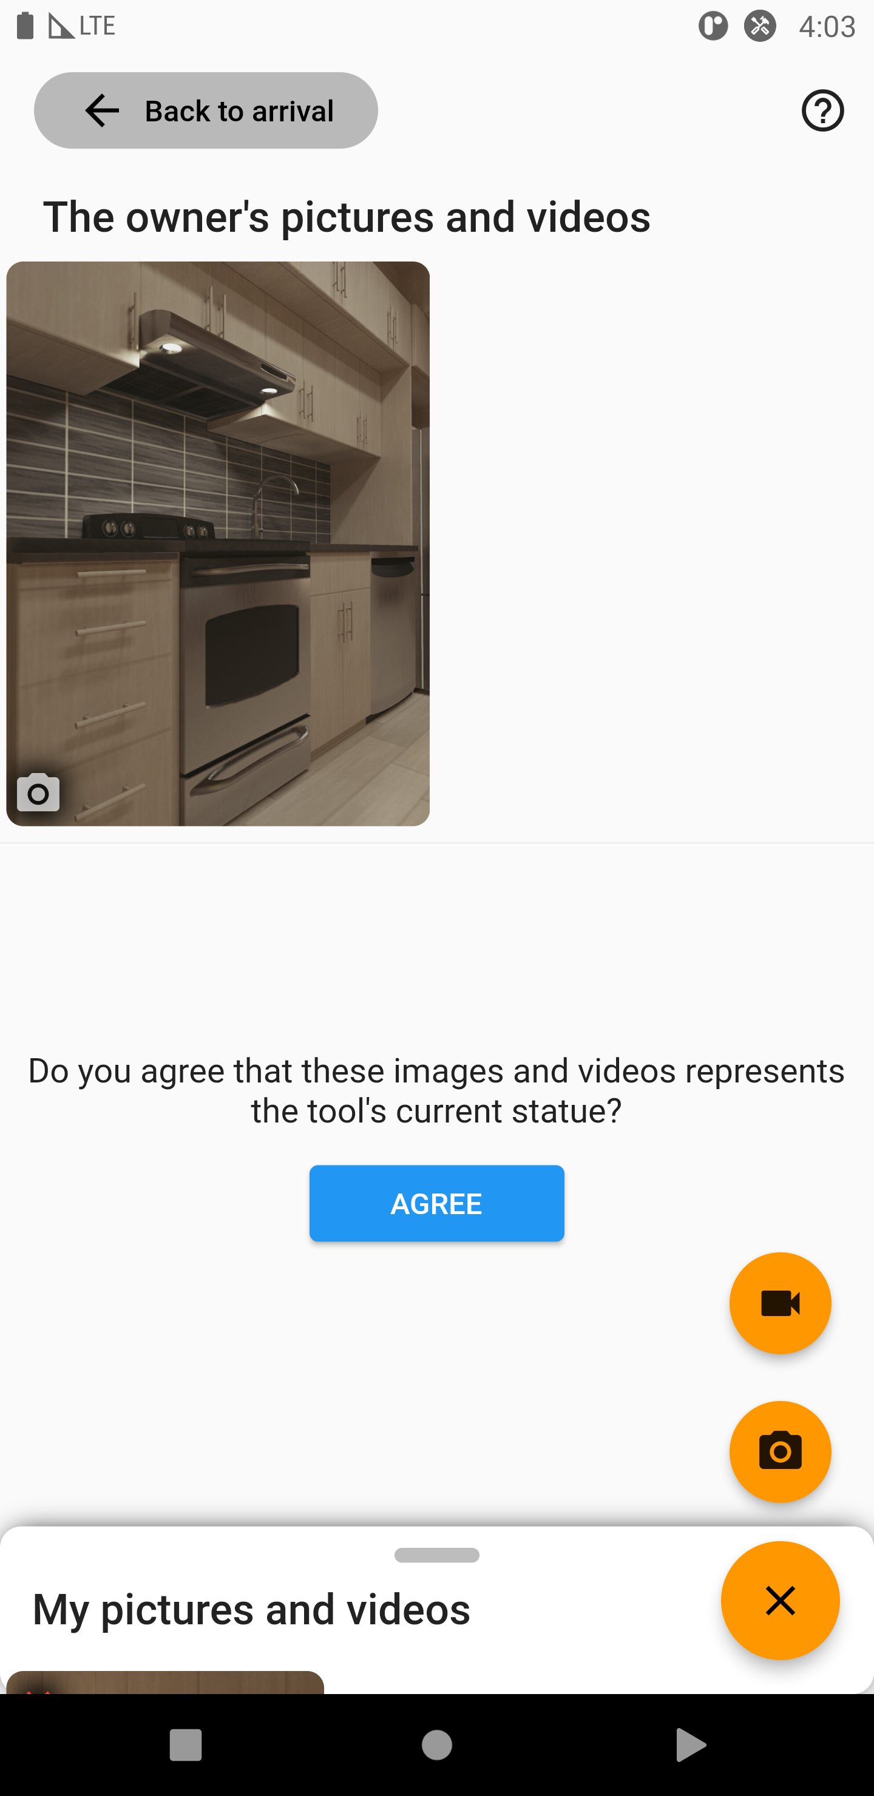
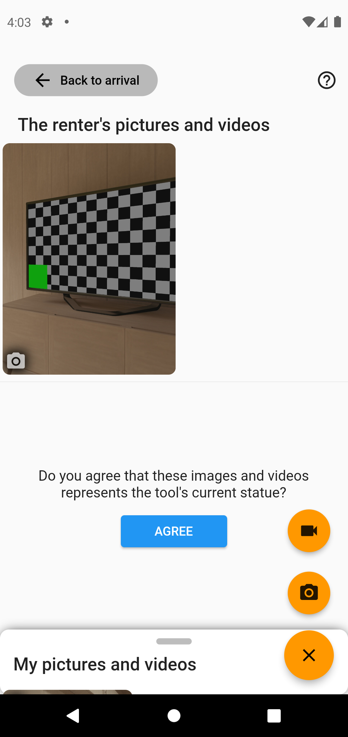
The delivery meeting flow
Renter
Owner

Slide 14
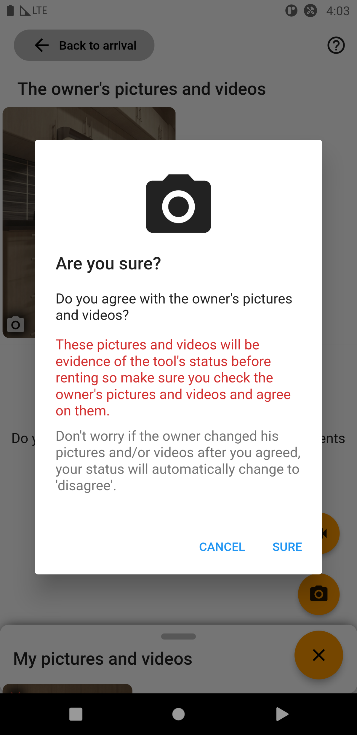
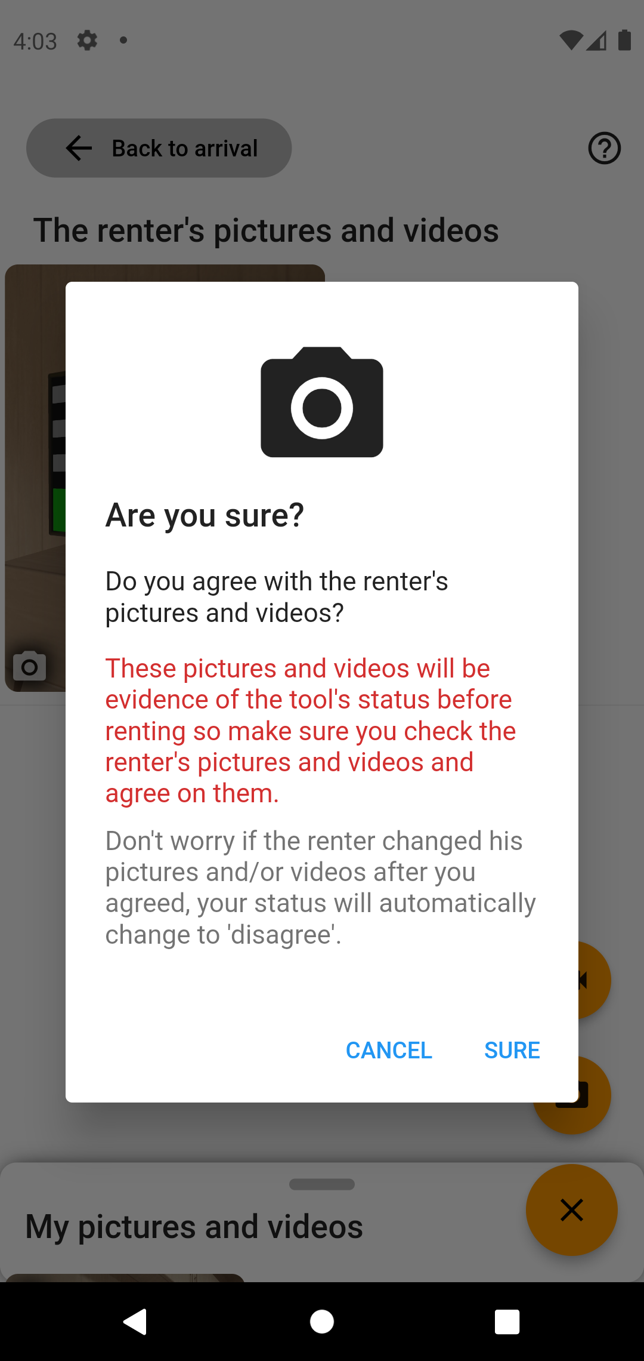
The delivery meeting flow
Renter
Owner

Slide 15
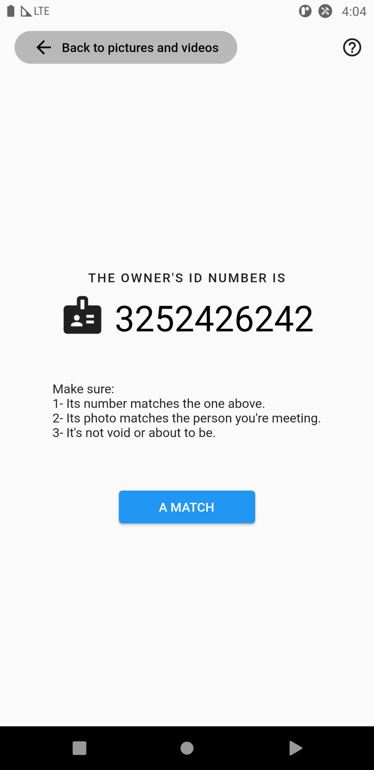
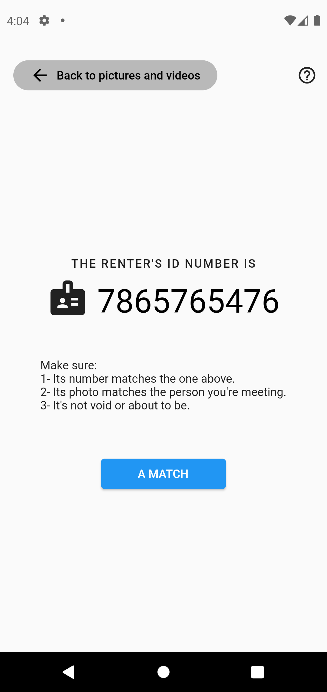
The delivery meeting flow
Renter
Owner

Slide 16
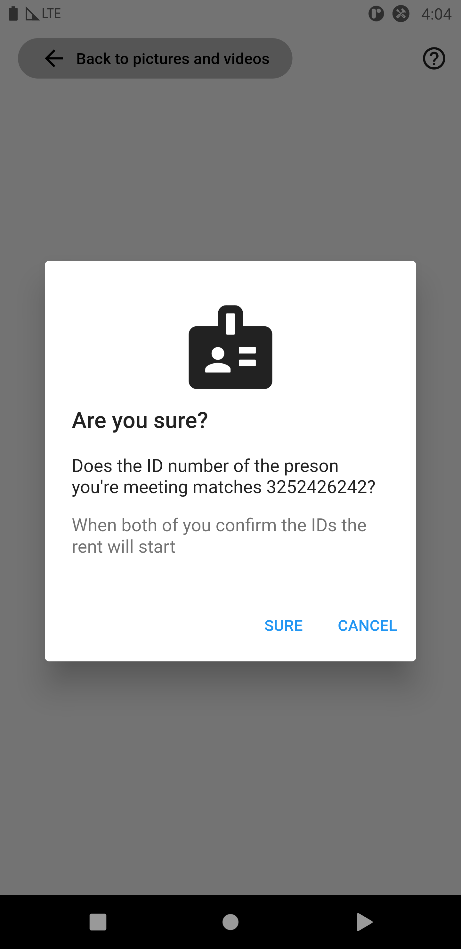
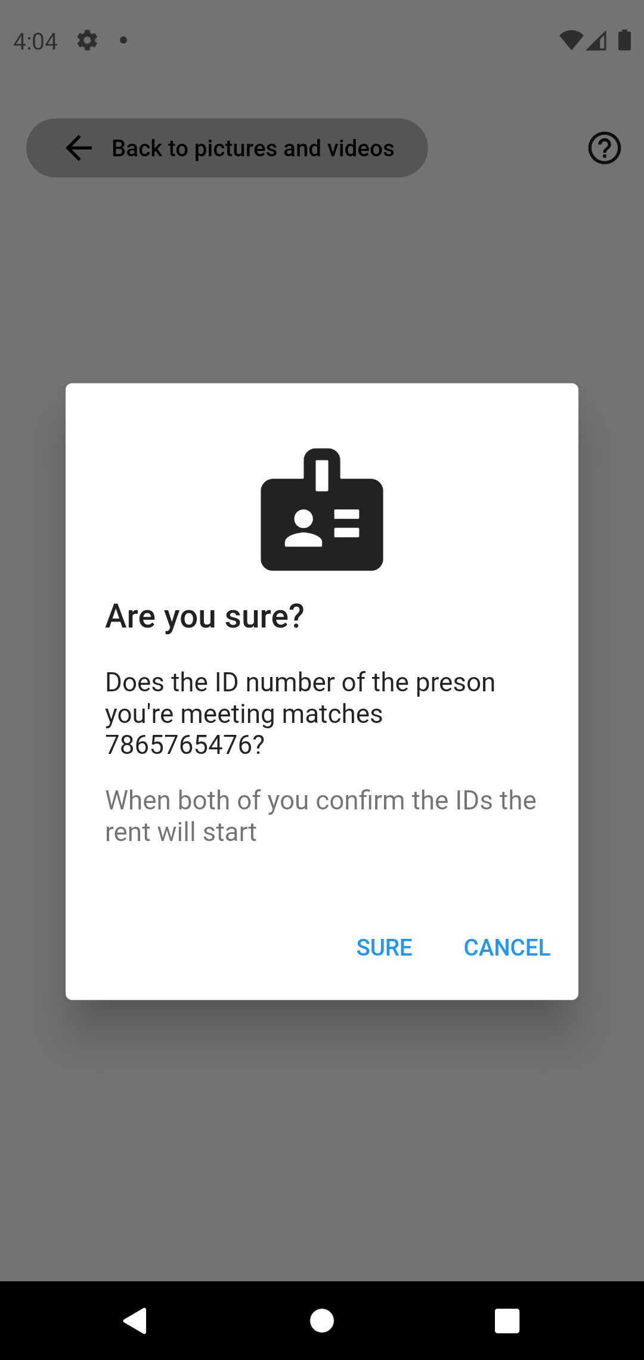
The delivery meeting flow
Renter
Owner

Slide 17
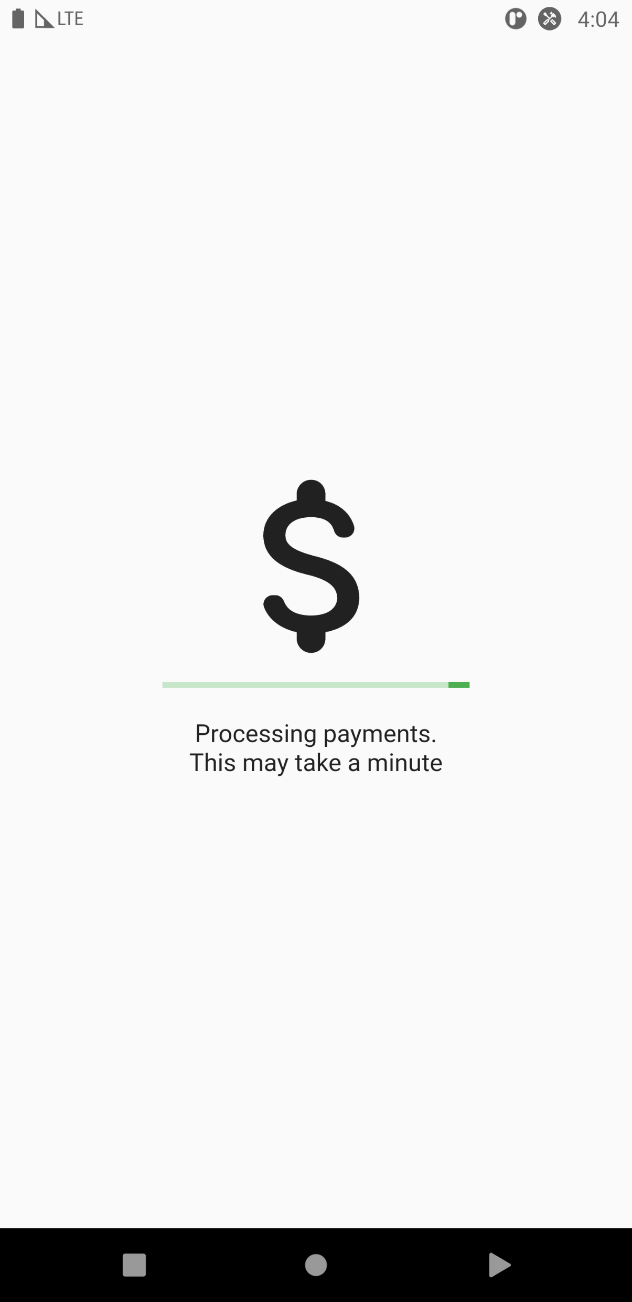
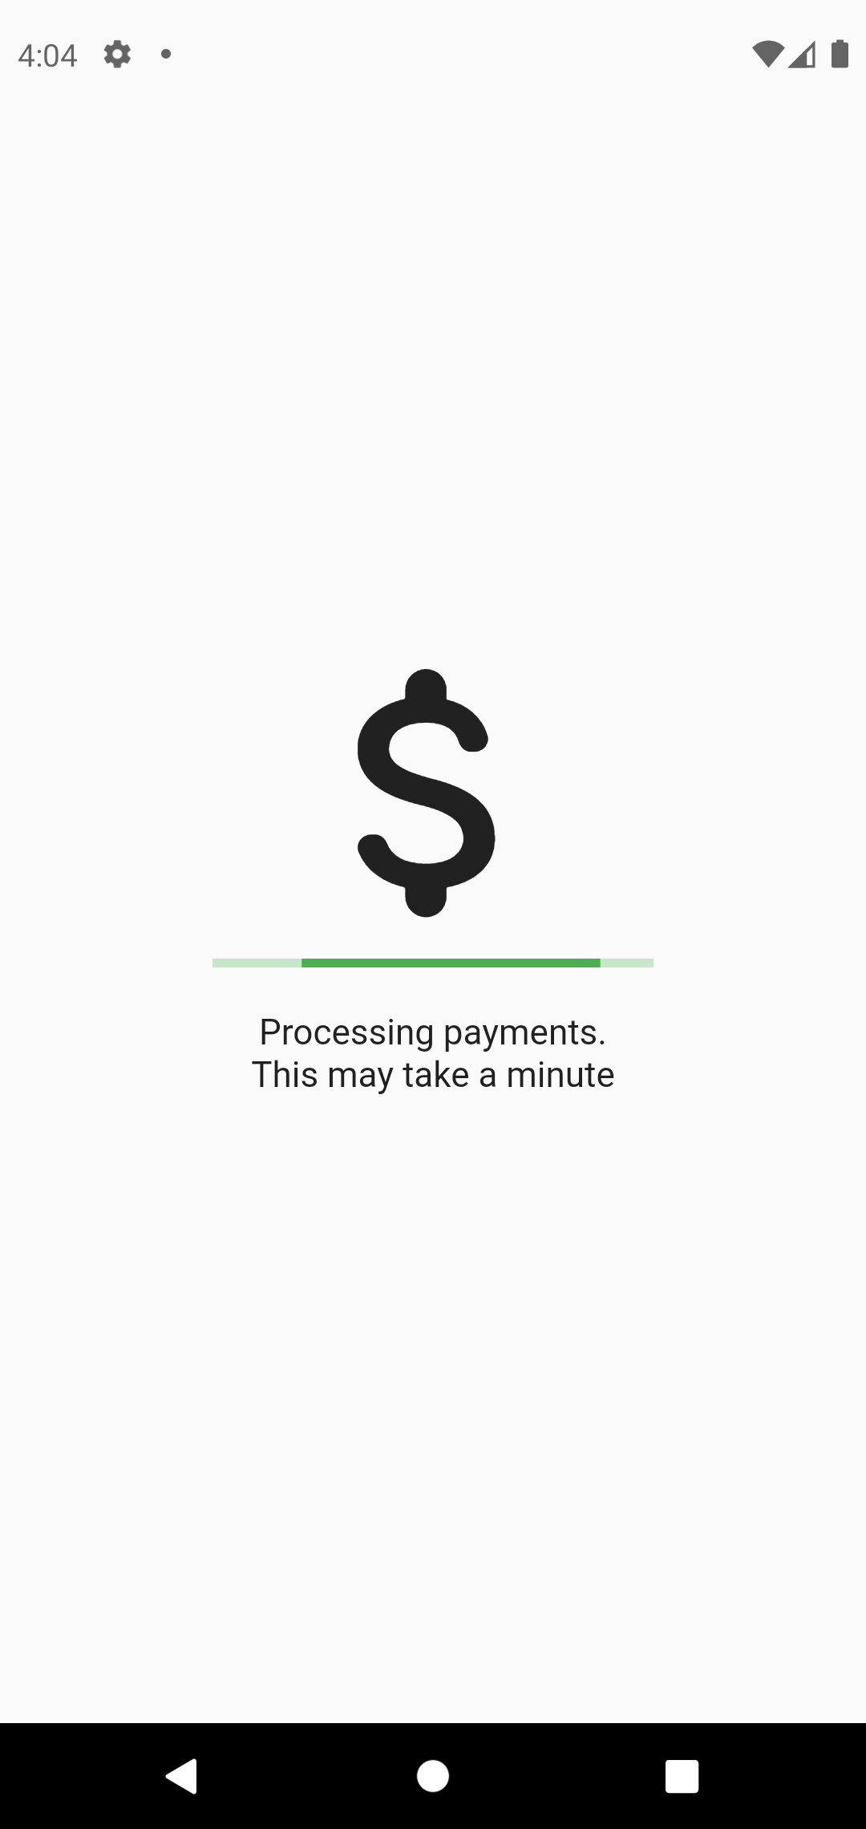
The delivery meeting flow
Renter
Owner

Slide 18
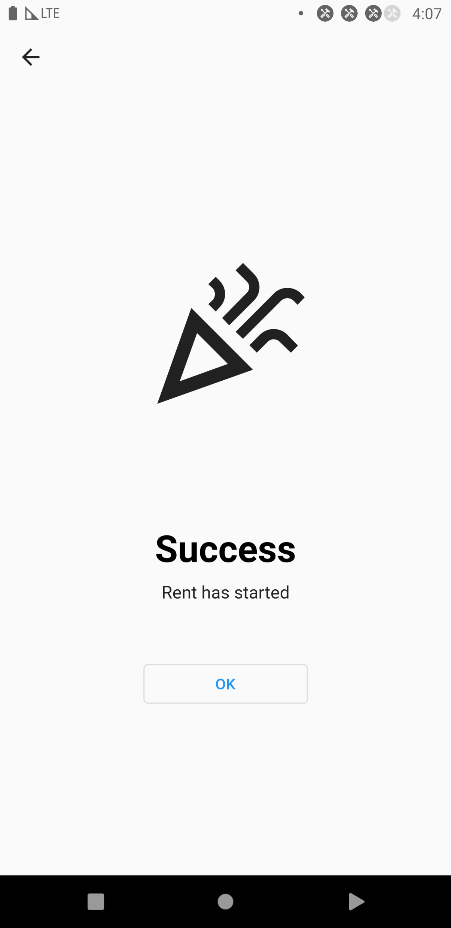
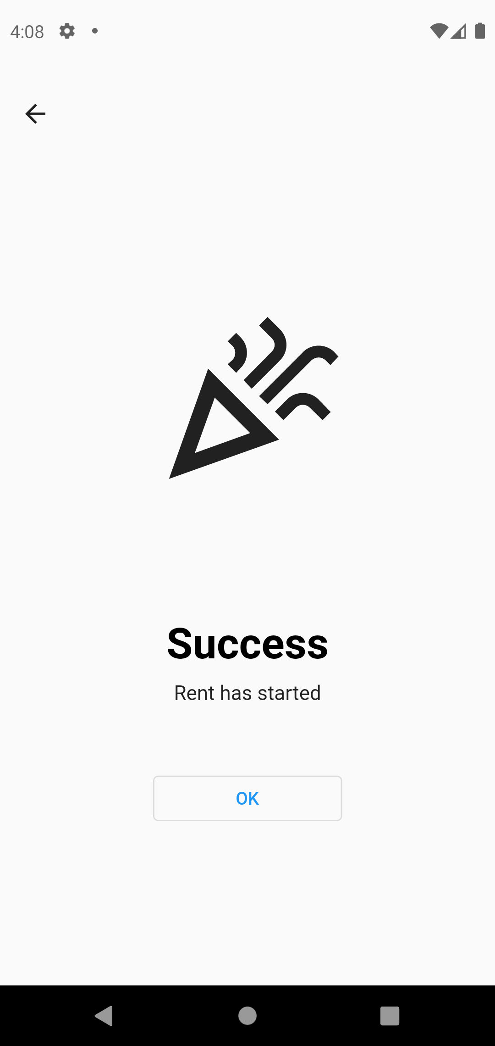
The delivery meeting flow
Renter
Owner

Slide 19
Disagreement cases

Slide 20
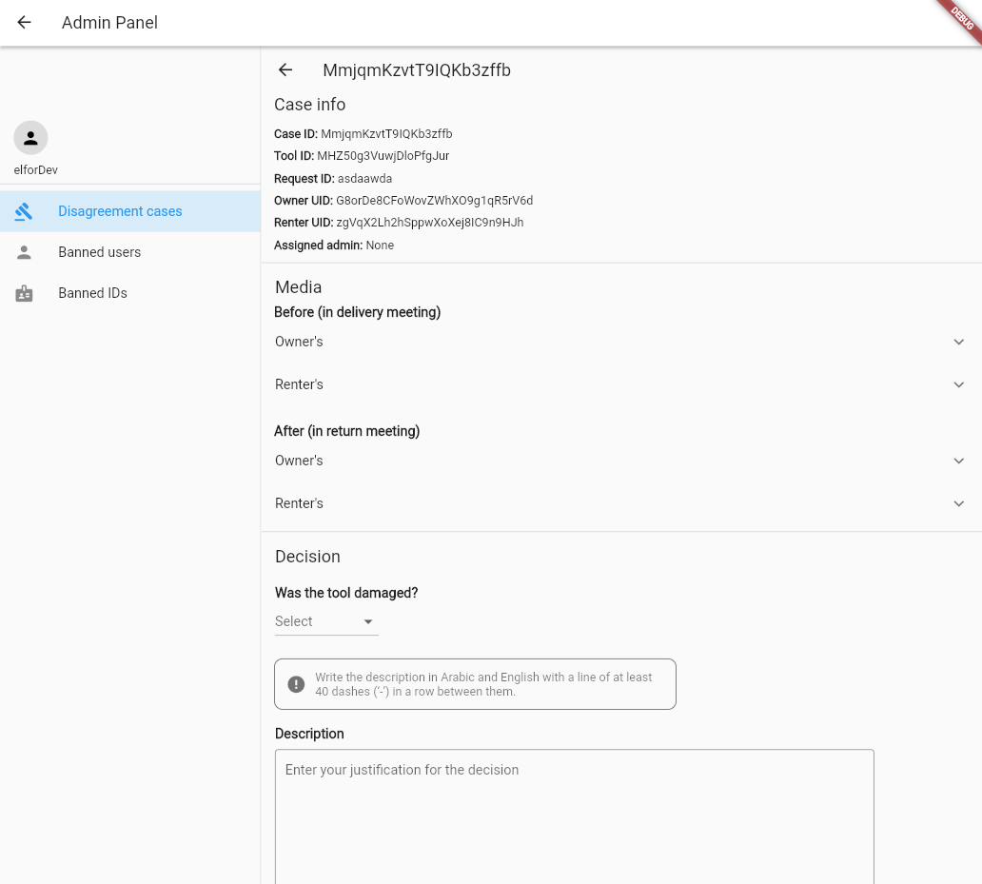
Disagreement cases
When returning the tool to the owner after the rent. If the owner claims the tool was damaged and the renter denies damaging it, the app will prompt them to take picture and videos of the tool. Then, after they’re done, a disagreement case
will be created.
An admin will then have to review the case and arrive to a decision. The admin will use the pictures and videos taken before the renter took the tool and after to arrive to the decision. Once he/she does, a notification will be sent to the renter and owner informing them of the decision.
Screenshot of disagreement case page in admin panel

Slide 21
How was it built?

Slide 22

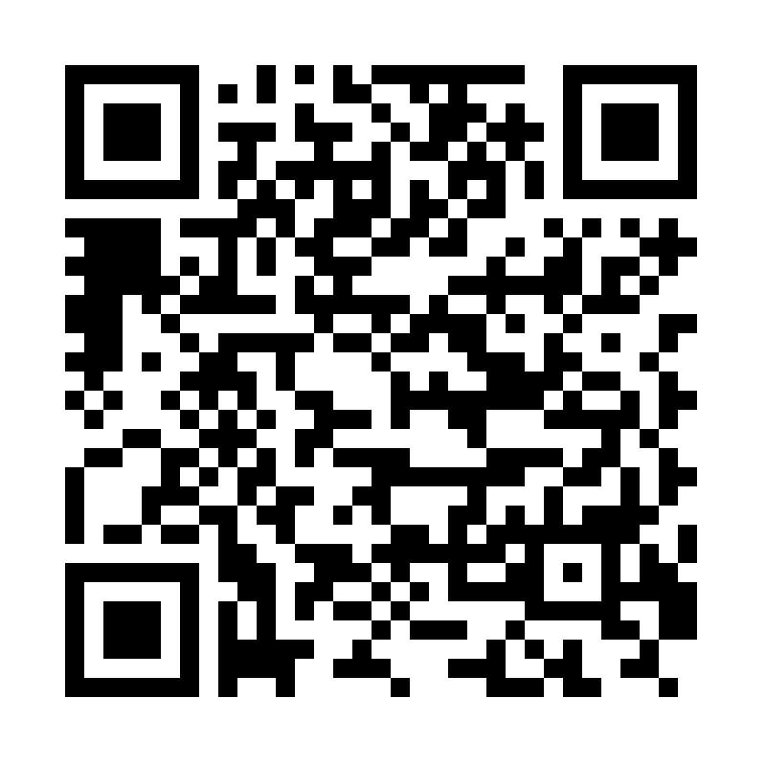
The front-end
The apps are built using the Flutter framework by Google.
Flutter allows the developer to create apps on multiple platforms using a single code base.
Rentool has three apps.
An android app.
Available on Google Play: shorturl.at/ovD57
A web app.
hosted on https://rentool.site.
An iOS app.
Google play link

Slide 23



The back-end
The system is deployed in the cloud using Firebase.
Firebase Authentication for users’ authentication.
Firestore as the database.
Cloud functions for running backend code.
Cloud Storage for storing the pictures videos and any other files the system needs.
Firebase Cloud Messaging for sending push notifications to users' devices.
And Firebase Hosting for hosting the web app.
Checkout is the payment gateway used to handle payments.
For searching the system uses Algolia.
Notes:
Firebase offer a lot of features and services that allows me to build the system without worrying about implementing these features and making them work together.

Slide 24

Authentication

Slide 25
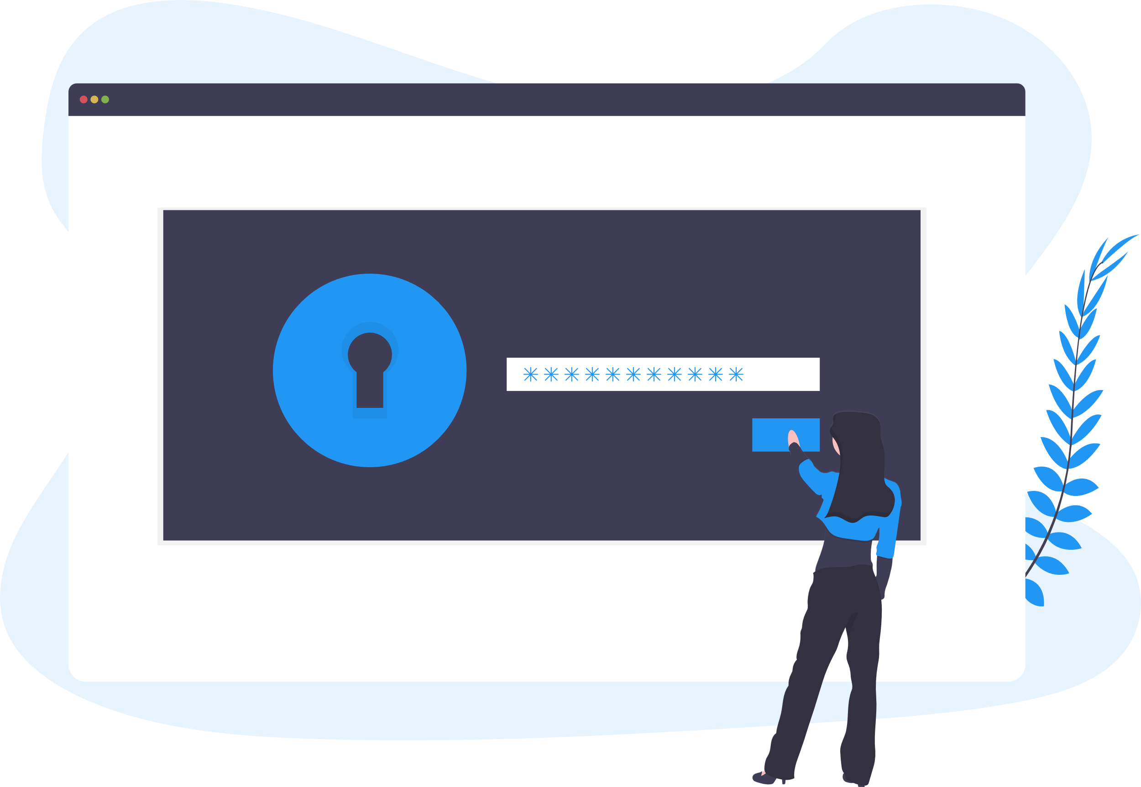
Authentication
The system uses Firebase Authentication to handle authenticating users and handling their passwords and tokens.
Firebase Authentication provides multiple ways for users to sign in. Such as:
Email and password
Phone number and OTP
Using identity providers such as Google, Facebook, and Twitter.
The methods used in Rentool are email & password and Singing in with Google and Facebook.

Slide 26
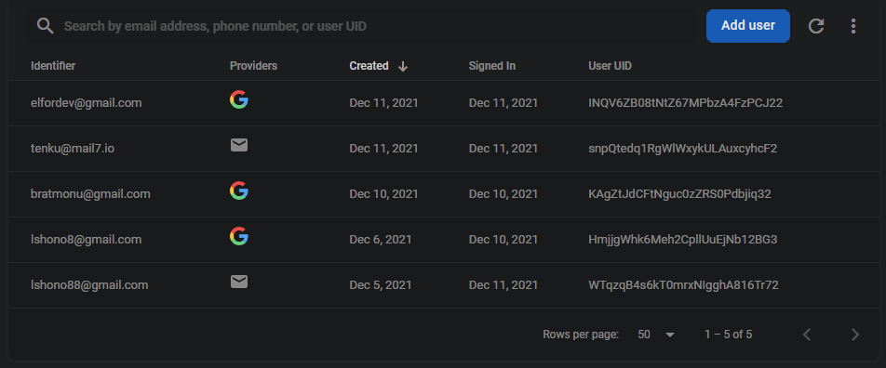
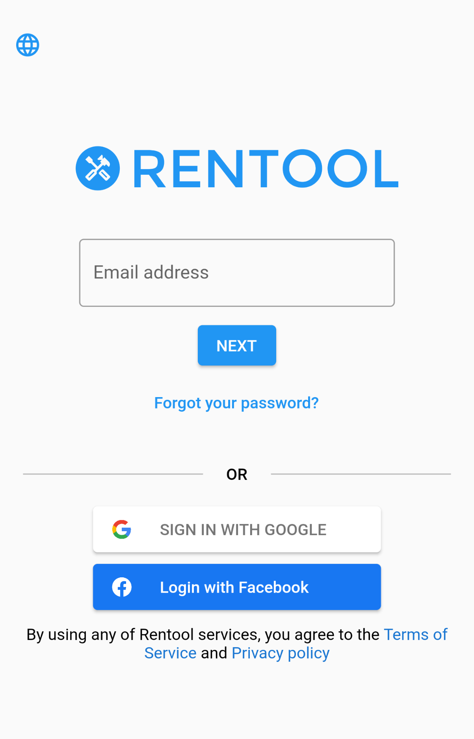
Authentication
Once a user account is created, it’s assigned a unique User ID (UID) which is used as a reference for this account.
Screenshot of the authentication tap in Firebase Console
Screenshot of the login screen in the app

Slide 27

The database - Firestore

Slide 28
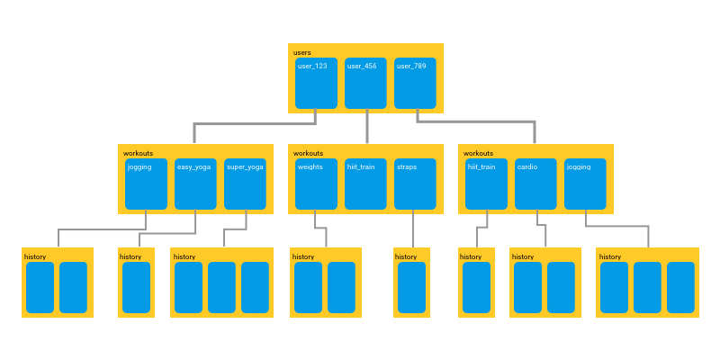
The database - Firestore
Firestore is a NoSQL database that stores the data in documents inside of collections, Not as tables but more like maps (like a JSON file).
Firestore starts with a list of collections that each contains a list of documents.
Each document has an ID that it can be accessed by. And it contains a list of key-value fields and has a list of collections (subcollections).
A diagram of how data is stored in Firestore.
NOT an actual view of Rentool’s database.

Slide 29
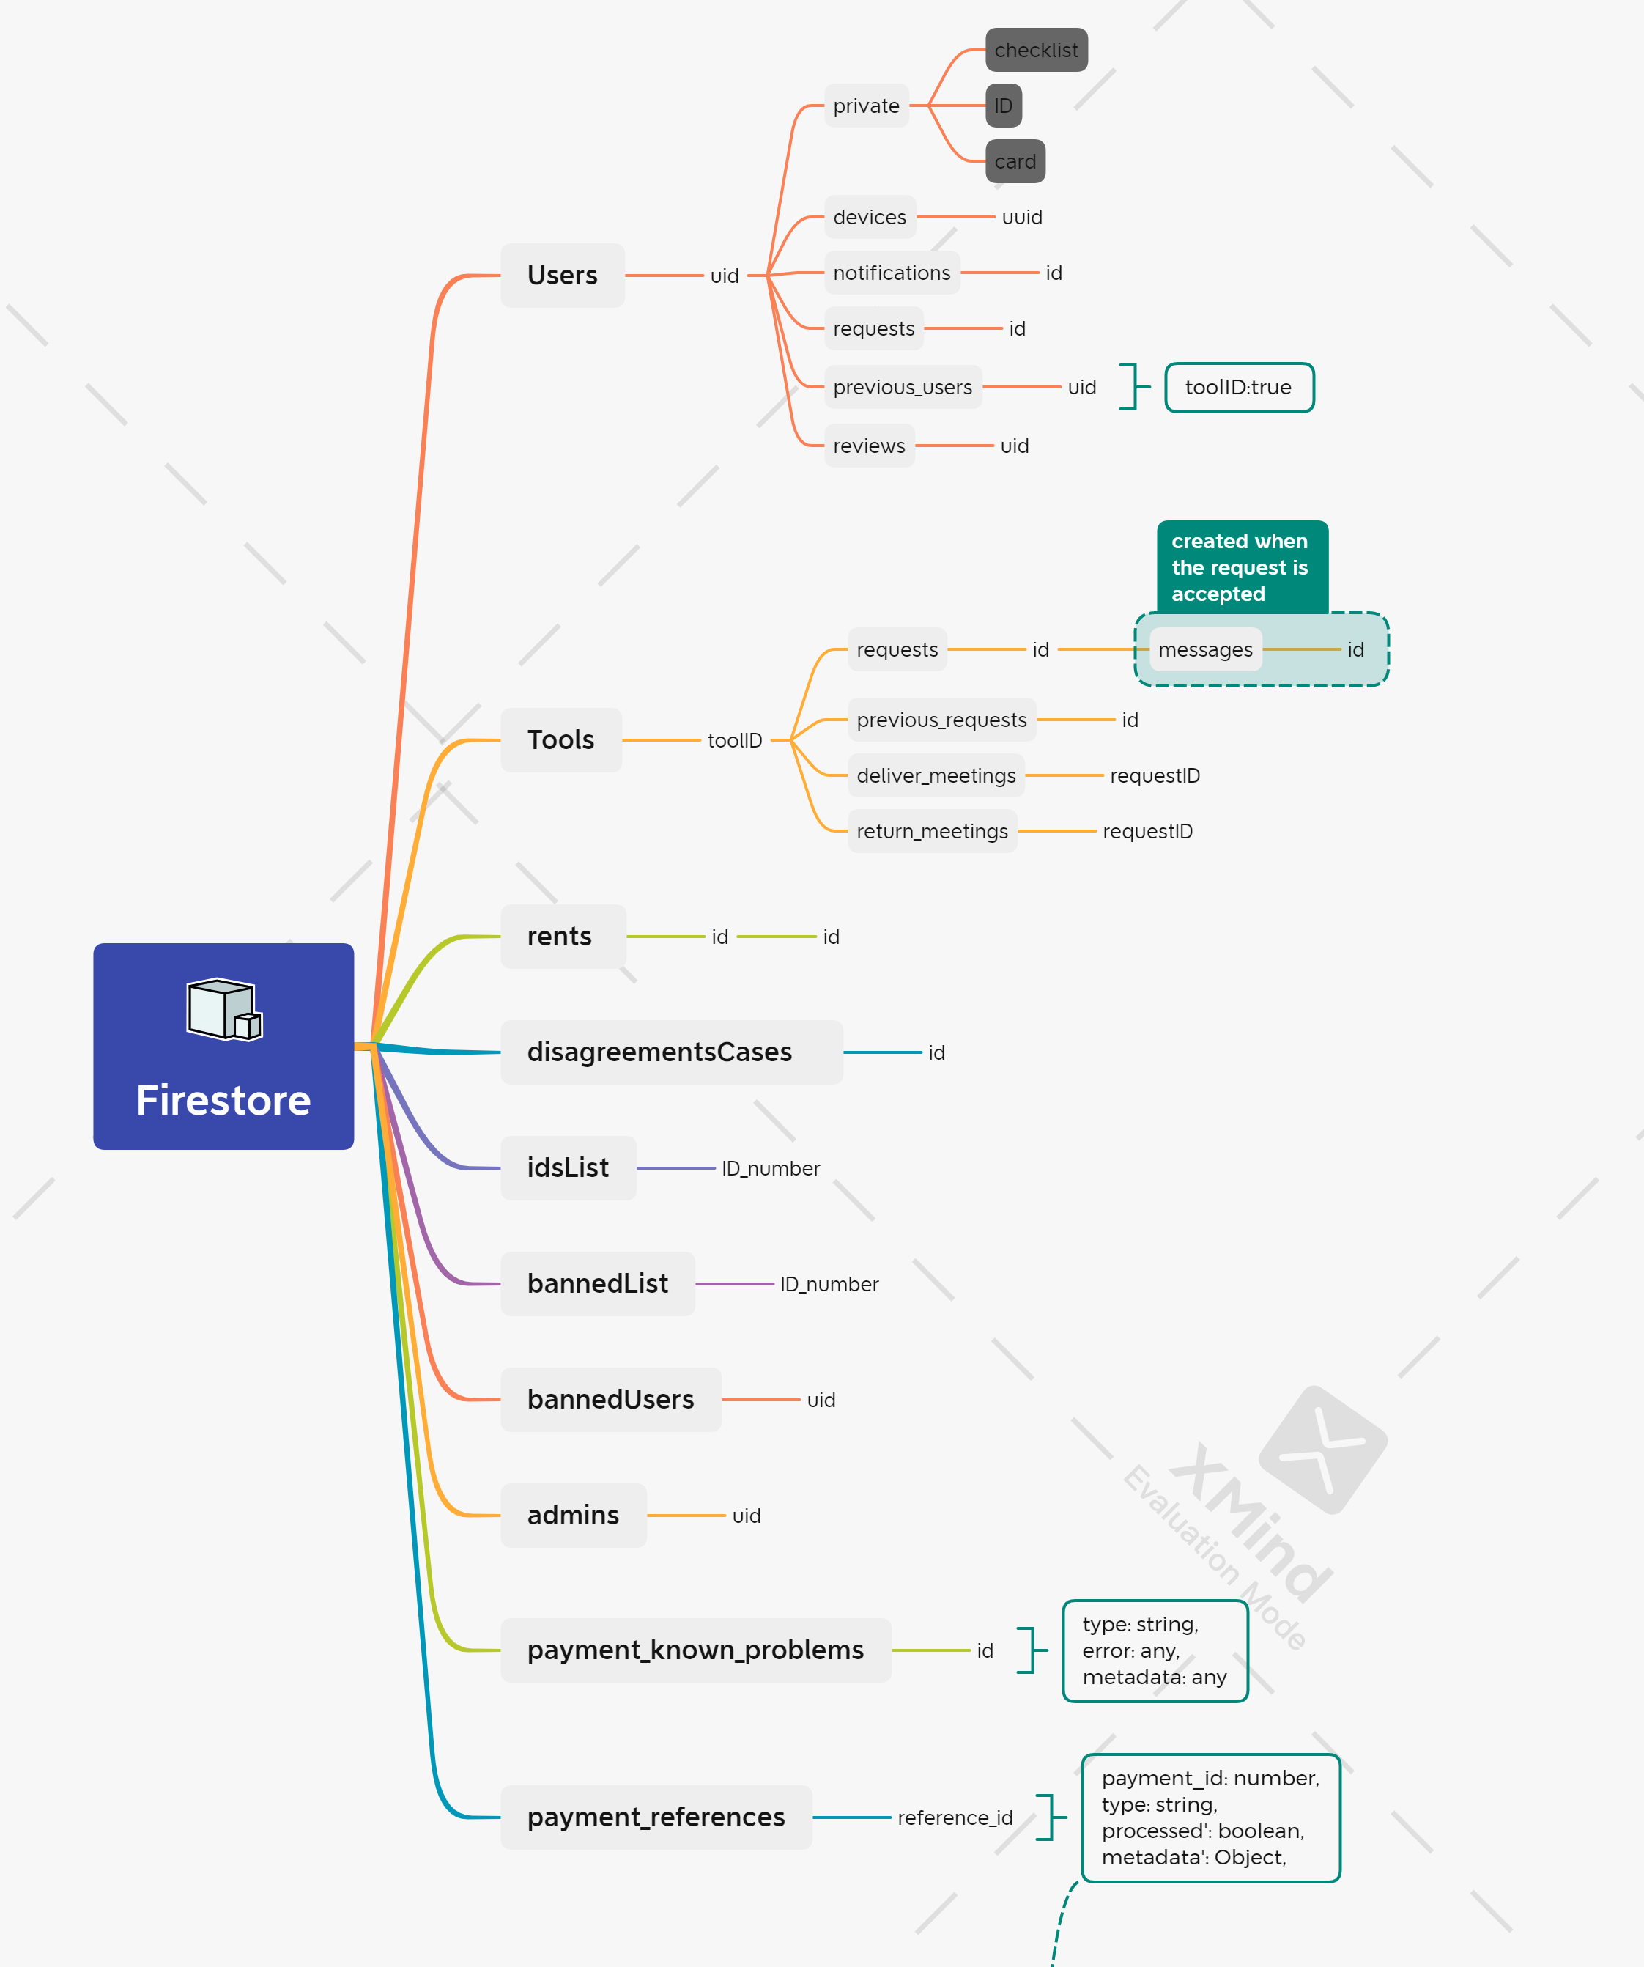
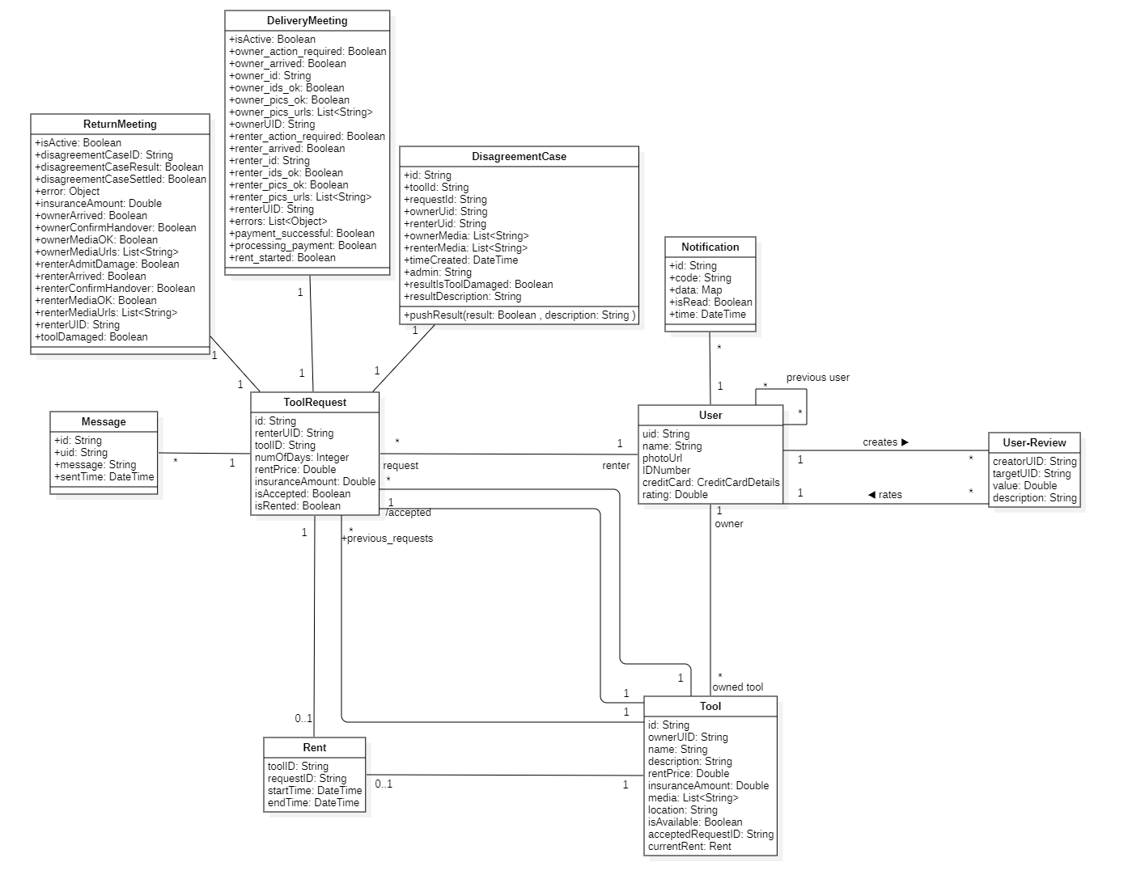
The database design

Slide 30
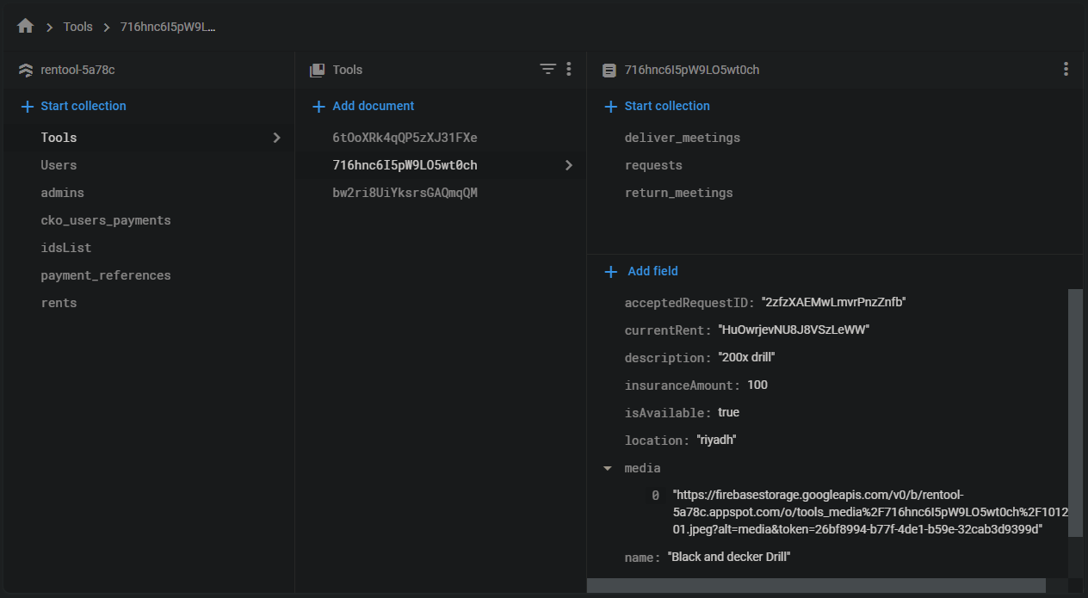
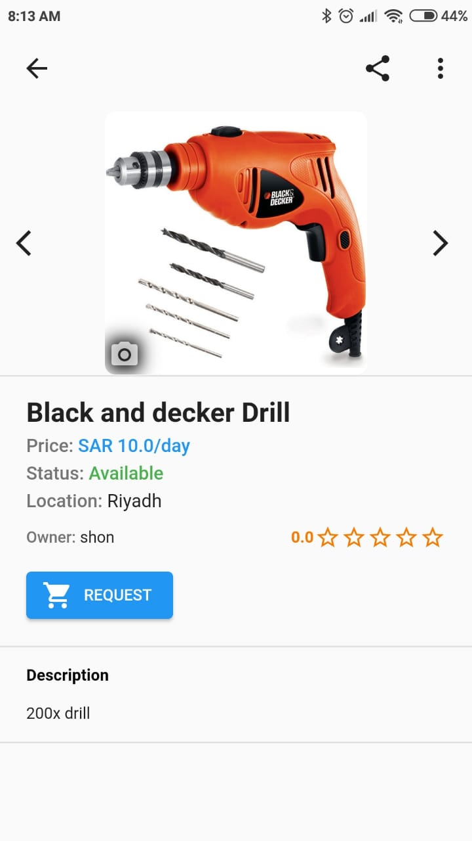
Screenshots of the database from Firebase Console
Screenshot of the tool (716hnc6I5pW9LO5wt0ch)’s document.

Slide 31

Firestore Security Rules
Security rules are a set of rules that control access to documents and collections in Firestore. They work by a ‘match’ statement matching a document path and an ‘allow’ expression detailing when reading or writing to the document is allowed.
They can also be used for data validation.
Below is a simplified example of security rules for the ‘Tools’ collection. (This is not the actual rules deployed for Rentool)
// This match statement matches any document in the ‘Tools’ collection.
// For example, it’ll match both documents ‘Tools/23lkjf12’ and ‘Tools/8fsh39d’
match /Tools/{tool_id} {
// allow only signed in users to read the document.
allow read: if request.auth != null;
// allow only the user that his/her UID matches the tool’s ‘ownerUID’ field
// and the ‘name’ field (the tool’s name) must be a string.
allow write: if request.auth.uid == resource.data.ownerUID
&& request.resource.name is string.
}
Notes:
Access control in Firestore is determined by its security rules.
// and `tool_id` will be a variable that can be accessed in this `match` body.

Slide 32

Cloud Functions

Slide 33
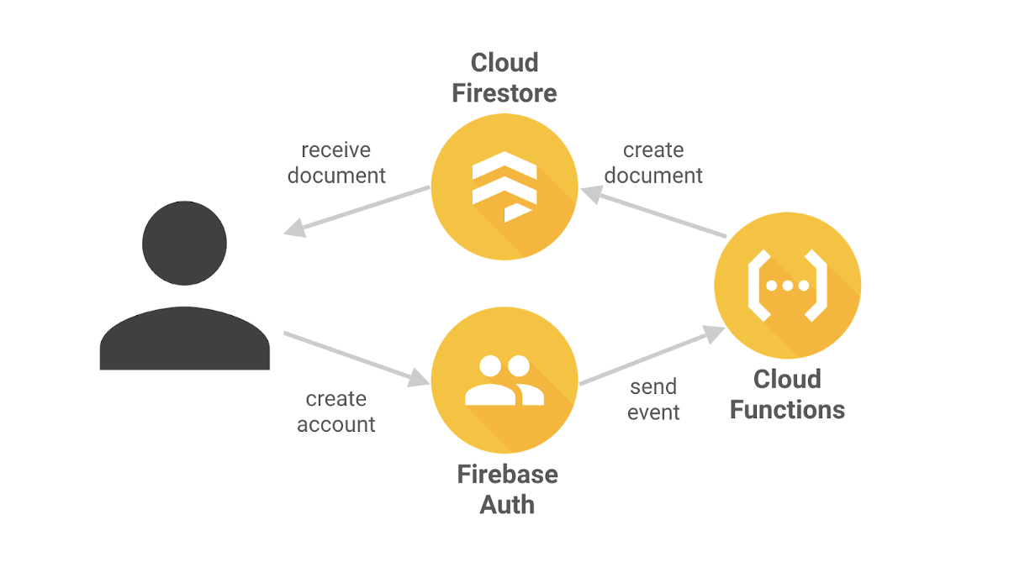
Cloud Functions
Are functions that are triggered by HTTPS calls or Firebase products, such as changes to in the database, new user sign-ups via Auth.
There are 19 Cloud Functions deployed for Rentool. Most of which are Firestore listeners that listens to changes in the database and handles them. For example, when an owner change the accepted request ID in the tool’s document a function will mark the request document as accepted and send a notification to the renter.
Other functions are HTTPS callable some used for changing the user’s profile picture or username. And one is used as a webhook with Checkout to receive payments events.
The cloud function ‘newUser’ runs when a new account is created, and it creates its user document in Firestore.

Slide 34

Payments
Using Checkout.com

Slide 35
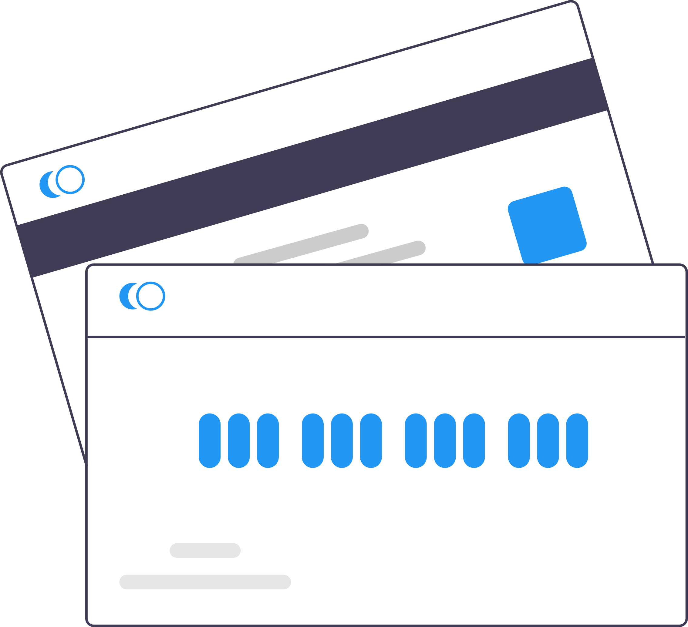
Payments
Rentool needs to send and receive payments from users to be able to charge the renter and pay the owner.
That’s why it needs a payment gateway that will take care of contacting the banks and handling transactions. Also, since Rentool is not PCI-Certified it can’t store users’ credit/debit cards directly. So, it needs a gateway that does that.
Checkout is a payment gateway that does support saving card details. In-addition to a great feature which is Card Payouts. This feature enables Rentool to send payments to the owner’s card directly. Thus, removing the need for the owners to enter their bank details like other e-commerce platforms.

Slide 36
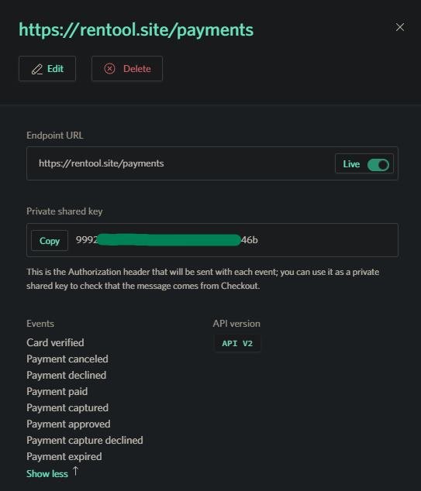
Payments – Webhook
Rentool stays updated with Checkout using a Webhook.
The cloud function ‘payment’ is an HTTPS function deployed on https://rentool.site/payments as an endpoint to a webhook between Rentool and Checkout.
Checkout sends an HTTPS request once one of the configured events occur, this is then used to trigger other events.
For example, after charging the renter, Rentool waits for confirmation that the payment was successful before paying the owner.
Webhook configuration page in Checkout dashboard.

Slide 37
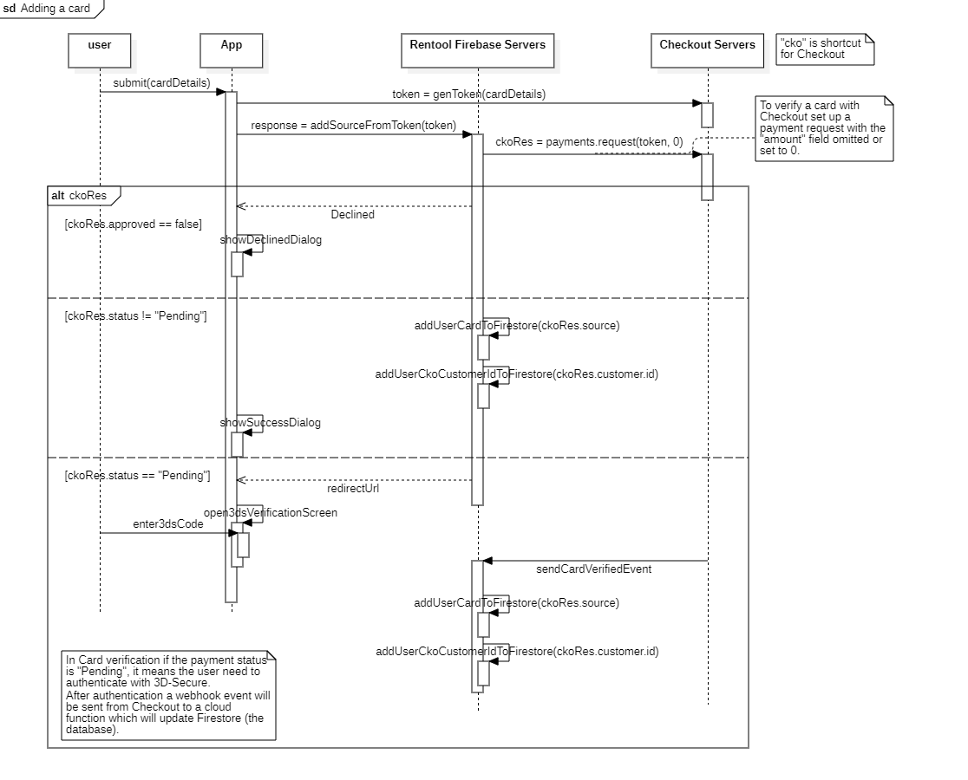
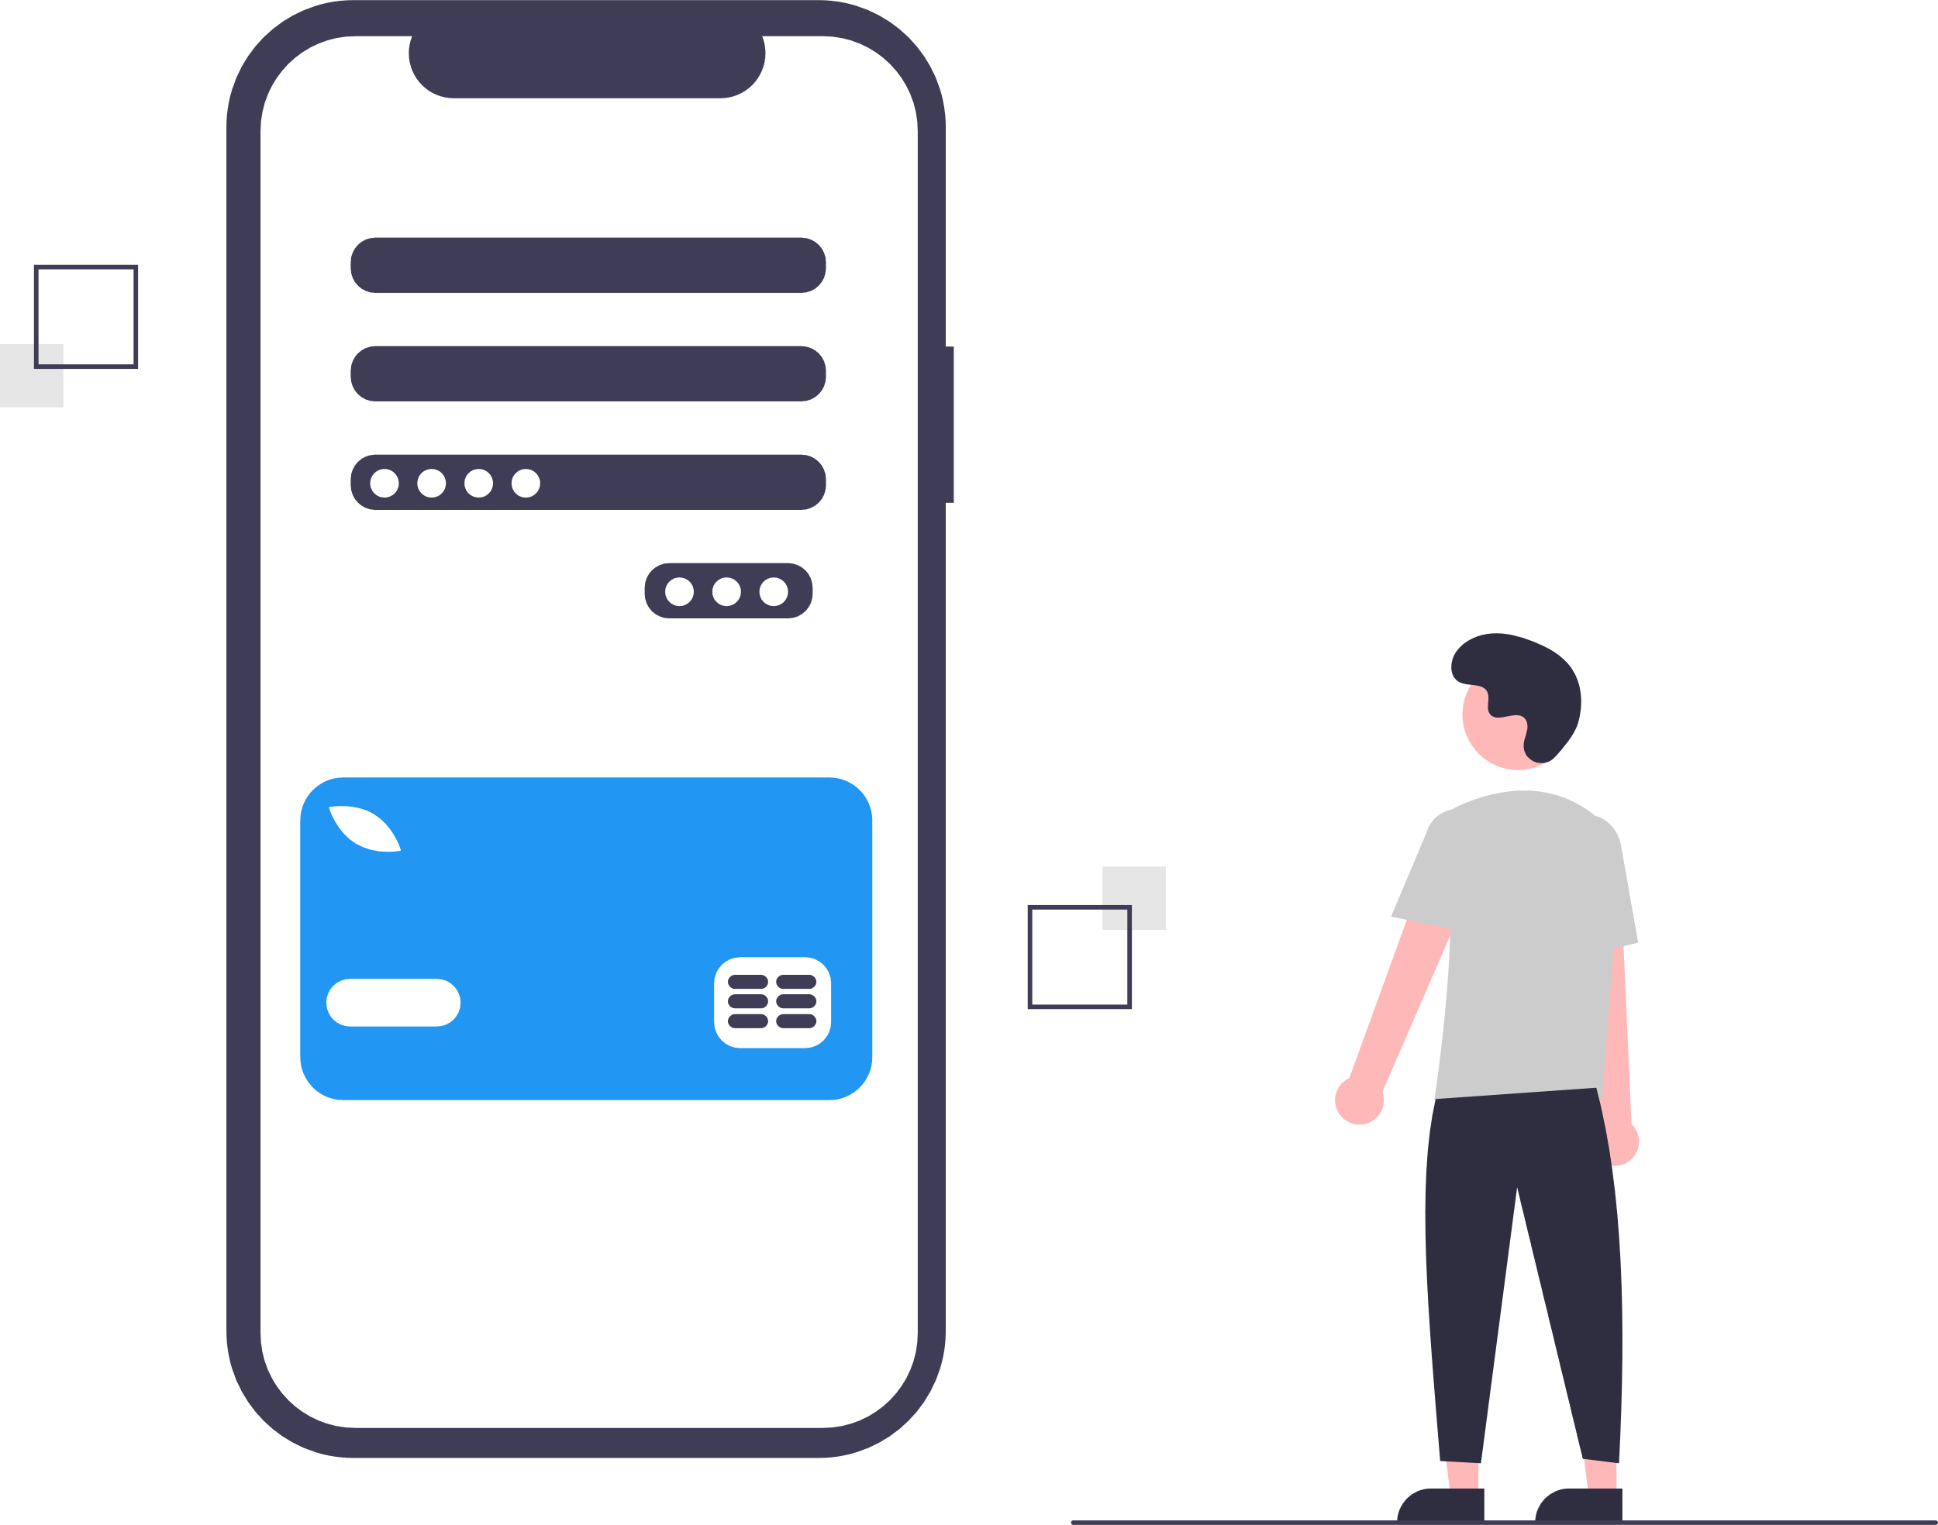
Payments – Adding a card
Since Rentool is not allowed to handle card details. The user will send his/her card details directly to Checkout. Which will store them and return a token to the user. The user will then send the token to Rentool which will contact Checkout and verify it.
Below is a sequence diagram of adding a credit/debit card.

Slide 38



Payments – Adding a card
Since Rentool is not allowed to handle card details. The user will send his/her card details directly to Checkout. Which will store them and return a token to the user. The user will then send the token to Rentool which will contact Checkout and verify it.
Below is a sequence diagram of adding a credit/debit card.
1-Request token
2- Return token
5- Verification status
4- Verify token
3- Add card from token
7- Return response
6- Update database

Slide 39


Source control Continuous integration Continuous deployment.
Using Git and GitHub.

Slide 40
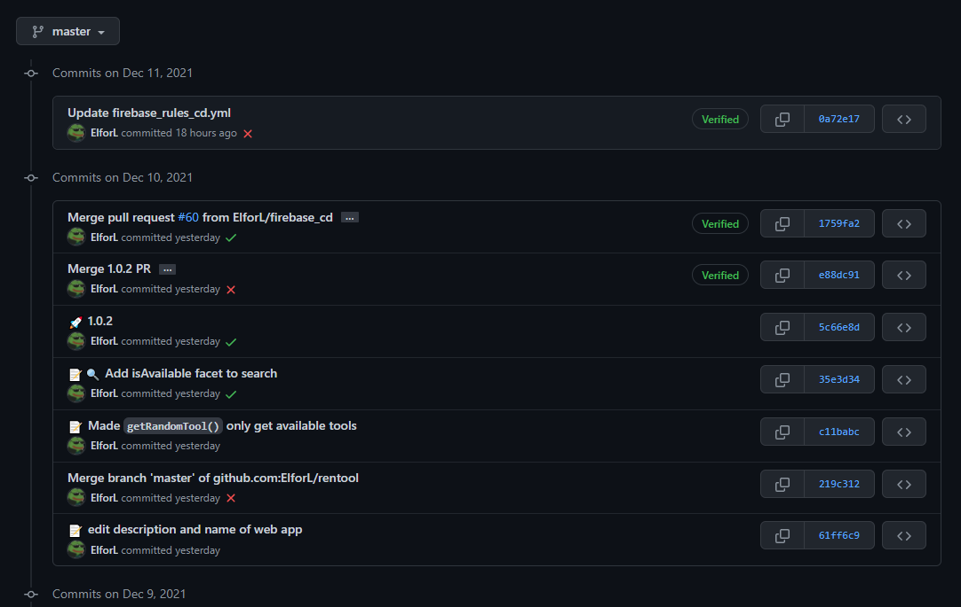
Source Control
Rentool is source controlled using Git and uploaded on GitHub. Meaning all changes to the code are managed and tracked with Git. And any changes can be rolled back in case of any problems.
This also provides a history of all the changes. Which is accessible by calling the command ‘git log’ or by checking the history in GitHub just like the screenshot on the right.

Slide 41
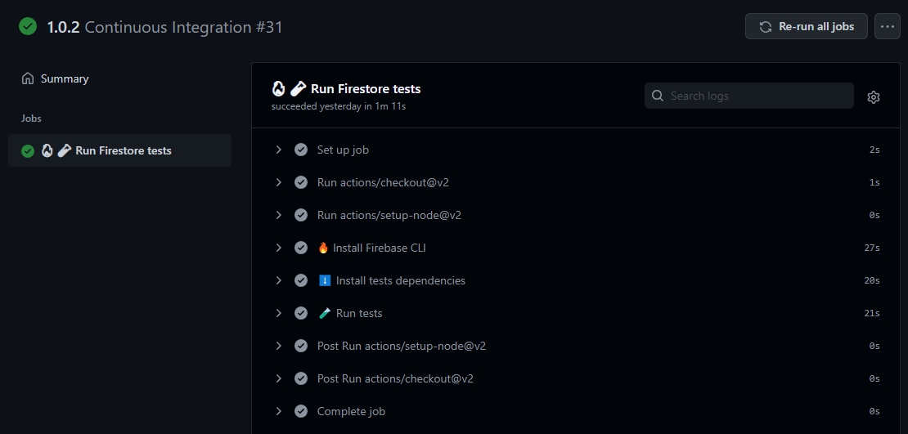
Continuous Integration (CI)
Using GitHub Actions, whenever a pull-request is created on the master branch, GitHub will run Firestore tests to ensure the changes doesn’t break the system.
On the right is a screenshot of the Continuous Integration (CI) action running on pull-request #31. This PR had the changes for the version 1.0.2 of Rentool apps.

Slide 42
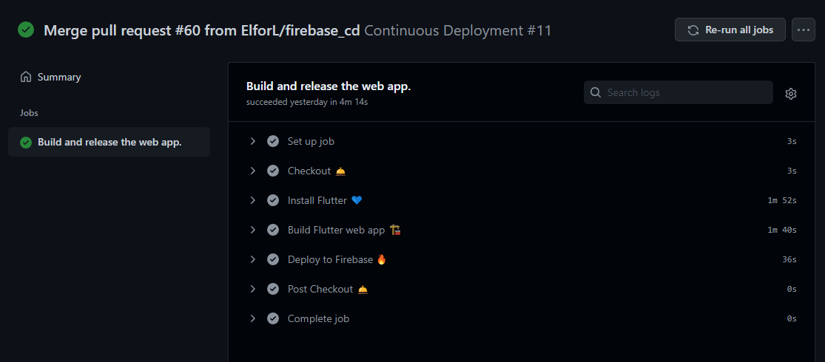
Continuous Deployment (CD)
GitHub will build and deploy the web app whenever the master branch changes. It also redeploys the Cloud Functions and Security rules if they were changed.
Below is the CD action after merging pull-request #60

Slide 43
Thank you.
Any questions?

